Slide 1
Value-Driven Scrum:
A Front End to Scrum
For Business Value Requirements
A One Day Course by Tom Gilb
March 14 2011, Unicom, London

Slide 2
Value Planning
The Organizational Components
Product Management
(deciding what the product should be)
Product Owner
System Architect
Scrum Teams
(building the product)
Scrum Master
Team Members

Slide 3
Value Planning
The Inputs
Product Management
(deciding what the product should be)
Stakeholders and their Needs
(like: Potential New Users, Usability)
Long Term Quality Needs
(like Portability, Security, Adaptability)
Scrum Teams
(building the product)
Requirements
(what to build, how well to build)
High Level and Super-ordinate
Designs and Architecture
(how to build, solutions given from others)

Slide 4
Value Planning
The Work Products - outputs
Product Management
(deciding what the product should be)
Product Owner:
Requirements, particularly top critical few improvement requirements
System Architect:
Technical Architecture to support long term
(like suppliers, interfaces, platforms, languages)
Scrum Teams
(building the product)
Scrum Master:
ensure team empowerment
Team Members: (IT)
Codes, Tests, System Improvements, Reports on progress, Work Process Improvements
Strategies, Designs, Solutions
(How we propose to deliver the improvements)

Slide 5
The Product Management Process
(Deciding The Exact Product Content)
Gather all relevant inputs: Analyze The Market and Related Environment
Stakeholders
Stakeholder needs
Clarify Needs and Organize the Information: Clear and Complete Requirements
Quantify Improvements and Constraints
Add info about risks, sources, priorities
Decide how to deliver the requirements – Product Design
Strategies, Design, Architecture
Estimate expected Impacts on Product Improvements and costs

Slide 6
Analysis: What You have to know
(done by Product Management)
Market Needs
Product Characteristics
How good? Qualities
Top 10 Critical Improvements
Service Characteristics
(help, training, fault support, sales channels, … )
Other Needs
Organizational Needs
IT Environment, Sales and marketing Environment, Distribution and Partners, International considerations, …
External Environment Needs
(legal, co-operation, image, ..)

Slide 7
Requirements:
Determining What You Want
What you need to determine
Top Level Critical Objectives
All other critical requirements
How well you need to determine it
Quantified, Unambiguous, Clear, Testable, Agreed and Approved, Quality Controlled
With supporting detail to allow analysis, risk understanding, prioritization

Slide 8
Design:
Creating the Product,
Deciding how to get what you want
What you have to design
Choose specific designs of product and service
(detailed enough to hand over to development team)
Choose specific architectures to deal with long term needs
(platforms, interfaces, processes, organizational structures, rewards)
How well you have to design it
So that you reasonably understand all critical attributes and costs
(±20%?)
So that the overall long term implications of the product are understood
(recruitment, partnering, international deals)

Slide 9
Building: The development team
What do you have to do?
Build Product
(Software, Dataware, Docuware)
Validate Product
(Does it work well enough?)
How well do you have to do it
To meet all targets, and constraints – for quality and performance. For New increments, and total system
To reflect on both product attributes and process problems.
To improve their own work environment. To improve the design, estimates and requirements.

Slide 10
Implementation: Integration: delivery to Market
What the team has to do
Integrate next increment into existing product and field/Beta trial it
Deliver to market as finished product change
How well it has to be done
So that it normally is clean (no bugs!) and impressive. So that we learn and can tune it before final market delivery
Rock solid. No problems. Clear improvement to all customers

Slide 11
Value Driven Scrum
Defined As:
  The real world interface to the Scrum Product Owner
  The Business Organizational Value Management
  The Business Function Management
  The Technical Architecture Management
All in a pipeline to the Scrum Product Owner (PO)
  Fully designed from the organization point of view
  Allowing design at the level of programming, chunking, and data
    By the Scrum Team
  Prioritized from the Organizational Point of View

Slide 12
The ‘Product Manager’ aka Product Owner
Needs to get enough information about the product
  To allow the Scrum team to build, test, make technical detailed decisions
Here is one set of tools to allow the Product Manager
  Perhaps, in larger environments, a PM team
  To collect information, to plan so that
We really deliver the best value for money as soon as possible

Slide 13
What is new?
What is Value-Planning (VP) ?
Dominant focus on Value Delivery Management –
  Not from a programming point of view
  But from a business and management non technical point of view
  Which critical value improvements do we need first, and next
Stakeholder Values and Priorities Integration*
  Of management, marketing, IT, Systems Engineering,
  Including Sales, Customer Service and ALL Critical Stakeholders
Systems View – Systems Architecture – Systems Engineering
* integration: defined as: Alignment and reasonable balance of competing interests, through intelligent dynamic prioritization.

Slide 14
Value Driven Scrum
System
Owner
Stakeholders Values
Business Values
Product
Owner
Build
Test
Maintain
Detailed Technical Design
System Functions

Slide 15
Game Zero: Agile Inspection of Requirements (30 minutes)
Rules
Process
1. Clear enough to test
2. Unambiguous to intended readership
3. No Design
  (Password -> Security)
Count probable violations
  Forget minors (can’t impact real product)
Report Majors to Tom

Slide 16
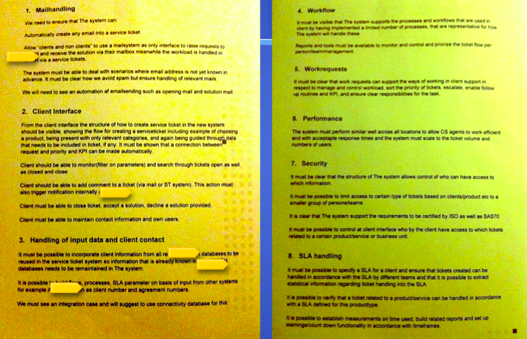
Page 1 & 2, Acceptance Test Basis

Slide 17
Evaluating the Requirement
Raw Major defect count
Extrapolation: real defect density.
Pages are about 300 words (327, 287)
23 30? 24 23 35
Other table
  6 5 14 14 10 12
Dennis: 65, words on page 2
If Exit was Max 1.0 major
  .
  Estimate majors found by Team = 2 x 35 ±10 = 70
  Inspection effectiveness is about 1/3rd 33%
  There are about 3 x 70 = 210 Majors on these pages on average.
  The total requirements has about 450 majors in the one requirement doc (701 word)

Slide 18
Game 1: Analyze Your Plans
Instructions
Examples
From plans or presentations identify the Top Critical Objectives
  Enhanced x, Improved Y, Reduced Z
How many of them are defined, somewhere, so that you could test and prove they were delivered?
How many of them are ‘what you really want?”
  As opposed to someone belief on how to get it?
    Which, if mistaken, might not get you what you want ?
Faster to Market (Time to Market)
Reduce Change Costs (Adaptability)
Better Integration [3rd Party]
Improved Employee Retention
Easier Recruitment
Reduce Tech Capability Bottleneck
Enhanced Market Responsiveness
  More Membership Growth
  Better Member Retention
  Greater Service Launch Speed
  Better Product launch Speed
  Enhanced User Experience
Notes:
Edited 11 Jan 2011 esp in examples

Slide 19
Game 2: Analyze A Value Objective – Ambiguity Test
Instructions
Examples
Pick one objective, maybe the most critical one
  Example: “Radically Improve X”
Ambiguity Test a.
  Each person on team defines exactly what is means by X
    So it cannot be misunderstood by anyone else
    Then show all variations to the whole team
  Did everyone define it the same way?
  Does it need better definition so everyone agrees to it and understands it the same way?
User Experience
  ‘Degenerating’
Defined as: takes too long to reach user objectives, sometimes not at all
Other aspects:
  They do not know what is available
  They don’t get what they expect

Slide 20
Game 3: Agree to one clear and useful definition of ‘X’, everybody concerned can understand
Instructions
Examples & Feedback
X: Defined as ………. Source: Agreed By The Group, Today *
What did you have to do to get agreement?
Why was this not defined and agreed earlier?
What are the consequences of not having an agreed definition of a critical objective?
* Source is a ‘prioritization’ tool!
User Experience
  ‘Degenerating’
Defined as: takes too long to reach user objectives, sometimes not at all

Slide 21
Game 4: ‘Radically Improved’
Instructions
Examples & Observations
Take a look at the ‘adjective’, Improved, Better, Competitive, Reduced, Enhanced, Mind Blowing, etc.
Everybody take a shot at defining the meaning of these future states precisely,
  so we can prove it has happened or is happening
What is the problem in clarifying these words?
“Degenerating”
  Implies ‘stop degeneration’
  Implies ‘Get back to where we were”
  Implies, maybe: Get better than where we were, sometime.
Interpretation:
  We need to improve radically or we are out of the market. <- GB
Notes:
Edited Jan 11 2011 tg

Slide 22
We need to Quantify Improvement Levels!
Stage 1: Define A Scale
Stage 2: Define Numbers on Scale
This is called quantification
  (not ‘measurement’)
This is a great step towards extremely clear definitions of critical objectives
You can ‘always’ quantify critical improvements
Example: Scale: the time needed to access a client telephone number and dial it.
At the very least you need a target number: Goal
  Example
  Goal: 30 Seconds
But it is useful knowing state of play:
  Past: 50 seconds
  Trend
  Record
And sometimes the worst acceptable level:
  Tolerable: 40 seconds
Notes:
Examples added Jan 11 2011

Slide 23
Game 5a: Defining a Scale of Measure for Critical Objectives
Instructions
Examples
Each person will try to define a suitable scale of measure
The team will evaluate suggestions
And negotiate a scale of measure
  In some cases a set of scales of measure are necessary
  But try to keep it simple for now
  User Experience:
  Ambition Level: We need to improve User Experience radically or we are out of the market. <- GB
Scale: average time for [Users: Default All] to Get [Key Information: Default = A Date].
  Get: defined as: to successfully acquire what they intended to get, from [Start] to Successful Completion, Date Shows Up.
  Start: a realistic point where user has an urge to use the system for some purpose. Even if they are not yet near an internet device.
Impacts: <higher level goals>

Slide 24
Scales: Hopefully you observed
We Suggest
You also observed..
Everybody had different scale ideas
Nobody referenced a ‘standard’ scale
Many people had good ideas that deserved to be considered and combined into the final solution
A really good scale takes time to draft (30-60 minutes)
But a good scale can potentially be reused on many projects
An a good scale can be made better when we discuss, think, get experience
There is no right answer, but it is usually possible to agree on an official version
Different levels of scales may give the opportunityto generalize a scale at a higher level (maybe using [Scale Parameters]

Slide 25
Game 5b: Now Quantify: ‘Improved’ as a difference between 2 points
Benchmarks
Targets*, Constraints*
Past [ 2009, US] 3 weeks ± 2 wk
Past [Competitor X, 2008] 1 hour.
Trend [2010]
Record [2009]
Ideal
Survival:
Tolerable:
Goal [ End 2010] 1 hour –> 1 week ?
Stretch [2011] < 1 hour
Wish
* These are powerful tools for intelligent and logical dynamic prioritization!

Slide 26
Was it difficult to Quantify?
Possible Problems
Solutions
Don’t have info
Info not exact
Info is a range
Info has dubious sources
Too costly to get info
Info depends on when
Info depends on where
Info depends on events

Slide 27
Stakeholder: Concept *233 .
‘Stakeholders’ are:
Any person, group or thing
that can determine our systems degree of success or failure,
by having an opinion about
system performance characteristics and
system lifecycle constraints

Slide 28

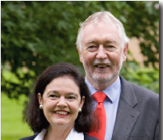
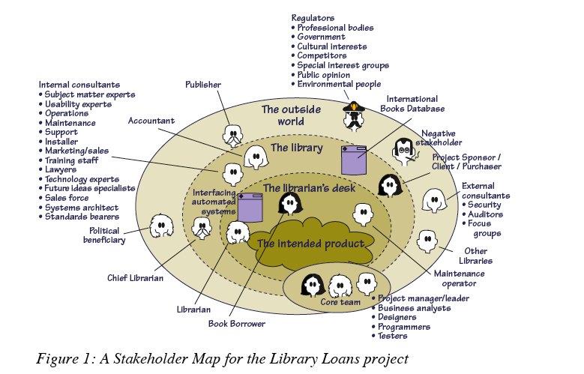
Stakeholder Map
Suzanne Robertson & James Robertson
Copyright The Atlantic Systems Guild, Used with Kind Permission.
http://www.requirementsnetwork.com/sites/requirementsnetwork.com/files/Volere_Requirements-A_Socio_Technical_Discipline.pdf
Notes:
Requirements – A Socio Technical Discipline
This is the fourth article in a series that explains the
thinking behind the Volere1 requirements techniques.
Subsequent articles will explore various aspects of
applying these techniques in your environment.
by
Suzanne Robertson & James Robertson
The Atlantic Systems Guild
February 2009
A Combination of Perspectives
On 8 Apr 2009, at 11:00, Suzanne Robertson wrote:Tom,Yes, with the usual copyright acknowledgements. What do you want to use it for?Have a happy EasterSuzanne

Slide 29
Stakeholders: Example of classes of stakeholders;
Example from real customer requirements definition about 1997, USAintelli
Government FCC
Telecompany Corporate
DEVELOPER
MANUFACTURER
  See detail next slide of probable values/requirements
OPERATOR (like AT&T)
DISTRIBUTION
LEASING/PURCHASE
PHONE USER:
System Owner (in office)
MAINTENANCE: Employees of system owner
Responsible Site Administrators
Responsible Installers
Repair Centers
Go to Stakeholder Exercise

Slide 30
Game 6: Stakeholders: defined as: People or things that can determine product/system success or failure.
Instructions
Examples
Each team will brainstorm a list of Internal and External Stakeholders (10-20 of each, 10-20 minutes)
Internal
  CEO
  VP Marketing
  VP Engineering
  Customer Services
  …
External (SFO!)
    Daters
    Long Term Relationship Hunters
    Dinner Date
    Gay Daters
    Transgender Daters

Slide 31
Stakeholders:
How to specify stakeholders together with their requirements.
The Planguage parameter term ‘Stakeholder’ can be used to specify one or more stakeholders explicitly.
  Internal Interests: Stakeholder = {End User, Help Desk, Installer}
We can attach stakeholder information to any elementary specification,
  Usability: Scale: Time to learn a task for a defined [Stakeholder]
  Goal [Stakeholder = Novice User] 10 minutes.
  Novice User: Defined As: anyone without any training in this system or task.
or to a set of specifications,
  Scale [Installers] time for successful installation
  Fail 20 minutes, Goal 10 minutes, Wish 5 minutes.
as appropriate.

Slide 32
Stakeholder Artifacts: Zachman zifa.com
Notes:
From Richard House , i-logue, London June 24th 2003
Zachman
Zachman - www.zifa.com

Slide 33
Observations
You should notice
And you also noticed
There are very many stakeholders
They are much more than a simple ‘customer/user’ notion
Some are inanimate
  Laws, policies, standards
They cannot all be interviewed
They may not know what they want, yet

Slide 34
Game 7: Stakeholder Values
Instructions
Examples
As a group, pick one critical stakeholder
Then list (a word or 2) a set of several (2 to 8) needs or values that the stakeholder is interested in
  They care
  They need
  They demand
  They require
  They Value
    Stakeholder: Long Term Relationship Hunters
      Info Credibility
      Safety
      Discretion
      Success Long Term
      …

Slide 35
Stakeholder Value: Observations
We Suggest
You also observed.
Most stakeholders have several values
Some of these values are shared by other stakeholders
  But not necessarily at same level or delivery time
Stakeholder value analysis is a useful process for discovering critical requirements that might be forgotten
You are going to need to define these values better:
  Scale, Goal, [2010, Lux, Teens]

Slide 36
Game 8: Simple* Design for Goal
Instructions
Reminder of the Objective (below)
For a given Goal level (the problem, the end, the target)
Identify possible (solutions, means, design, architecture)
Which you think, would allow us to reach the goal level, partly or wholly
  User Experience:
  Ambition Level: We need to improve User Experience radically or we are out of the market. <- GB
Scale: average time for [Users: Default All] to Get [Key Information: Default = A Date].
  Get: defined as: to successfully acquire what they intended to get, from [Start] to Successful Completion, Date Shows Up.
  Start: a realistic point where user has an urge to use the system for some purpose. Even if they are not yet near an internet device.
Impacts: <higher level goals>
Past [Competitor X, 2008] 1 hour.
Goal [ End 2010] 1 hour –> 1 week ?
Stretch [2011] < 1 hour
Brainstormed List of SOLUTIONS
iPhone: “iPhone” (any geographically conscious mobile device) Date Twitter based on Location.
Match Guru: Long Term Matching Guru
60Talk: One Hour Conversation Introduction
Friends: Work and Friends Connection
…
* Real design must consider many values, variables, and constraints

Slide 37
Game 9: Estimate Value Impact of your design
For the ‘best’ solution
Example
Estimate the potential impact of the solution towards meeting the Goal:
  100% meets it
  50% halfway
  1% trivial
Goal: User Experience, 1 Hour, Long Term
Solution: iPhone.
Impact %: 10% ± 9%
  Reasoning:
    Getting people 1 hour, easy
    Maybe less 1/10 works long term
Maybe list several independent opinions within your team:

Slide 38
Game 10: Estimate Uncertainty*
Get real: it is rarely ±0 % ☺
Instructions
Examples
Estimate Possible Deviation from the Main estimate:
Note why the deviation is that large?
  Make a list of several reasons why there is uncertainty with such estimates
Scale:
Goal:
Design:
Impact:
± Uncertainty: ±9 se prev slide
± Reason: see prev slide
List of ±? Reasons
* The ± % uncertainty can be used to spot risks, and to prioritize.

Slide 39
± Uncertainty:
You will have considered that:
We suggest
You also found or thought:
The solution was too general
  Not specific or detailed
  Like ‘Good Modularization’
High uncertainty = high risk of failure to meet Goal
No numeric data available on the solution
Action required… ?

Slide 40
Game 11: Credibility Index*
Instructions
Examples
For one of your estimates
Assign Credibility on a scale of
0.0 none
0.1 very low
0.5 moderate,
0.9 safe bet
1.0 dead certain
The estimate of _10%±9%__%
For Solution: _iPhone_
On Goal : __User Experience, 1 hour, Long Term___
Credibility: 0.3 ? <- Tsg
* The Credibility Index can be used to spot risks, and to prioritize

Slide 41
Game 12: Solution Cost*
Instructions
Examples
Estimate the relative cost of a defined solution on a scale of
0. totally trivial
1 very small
5 moderate
8 very high and uncertain
9 incredibly high and totally unknown
Solution : __iPhone__
Relative Cost: _5___
* This can be used to see risk and to prioritize solutions

Slide 42
Game 13: Priority
Instructions
Examples
Which solutions have the best value for money?
Expressed as
  Impact % for
  Cost ?
So which solution should we do first?
iPhone
  (no other options!)

Slide 43
Game 14: Priority Policy
Instructions
Examples
Name at least 5 different basis for prioritization (deciding what to do first)
Which one or ones would you recommend that your organization had as default policy
  (what you do unless you have a defensibly better idea)

Slide 44
The solution You prioritize
The Scrum Team will
Then the
Scrum Product Owner
Has the information needed to get
the Scrum Team to
“DO THE RIGHT THING” IN
“THE RIGHT ORDER”
Decompose it
Do detailed technical design
Allocate resources
Get it built in
Get it tested
See if it works as expected
  Are Goal levels delivered?
Give feedback to Business and System Owners

Slide 45



111111
The Unity Method 111111
for decomposition into iterative value delivery steps
Notes:
http://www.mindmapinspiration.com/unity/
©©©

Slide 46


´1´ 4 U2

Slide 47

One Bono U2
Notes:
48 seconds
Recorded from Utube off my Apple TV November 2010

Slide 48
´One´ lyrics
Is it getting better?
Or do you feel the same?
Will it make it easier on you now?
You got someone to blame
You say, one love, one life
When it's one need in the night
One love, we get to share it
Leaves you baby if you don't care for it
One love, one blood
One life, you got to do what you should
One life, with each other
Sisters, brothers
One life but we're not the same
We get to carry each other, carry each other
One
One
© POLYGRAM INT. MUSIC PUBL. B.V.;

Slide 49
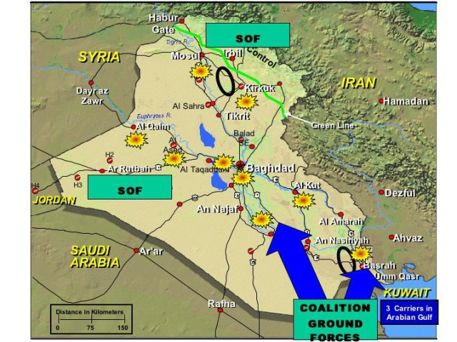
A True War Story
111111 in practice
How we found a value delivery step ´next week´
  a week of value delivery beat 11 years of waterfall method
Notes:
http://bbsnews.net/bbsn_photos/topics/US_Iraq_War/030322iraq_war_map.sized.jpg

Slide 50

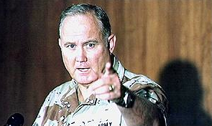
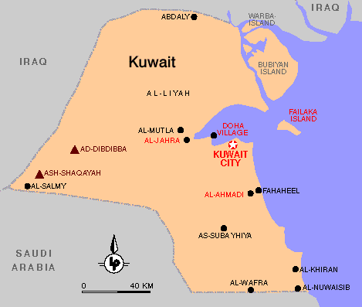
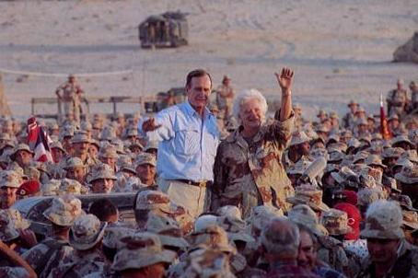
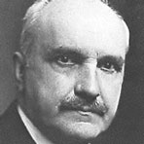
The Persinscom IT System Case
Commanding General
Norman Schwartzkopf
´Stormin´ Norman´
He who does not learn from history
Is doomed to repeat it
A Man Who understood that
“a bird in the hand is worth two in the Bush” <-tsg
Notes:
news.bbc.co.uk/1/ hi/england/2309205.stm
http://www.lclark.edu/~krauss/culturecapsulessp2001/AlUsaimiweb/images/map-pop-kuwait.gif
George Santayana (1863 - 1952)Quotes:> George Santayana (1863 - 1952), was Spanish writer and philosopher. He was, however, raised and educated in the United States and both studied and taught at Harvard. As a philosopher, he wrote 'The Sense of Beauty' , 'The Life of Reason' and 'The Realms of Being'.
A Man Who understood that a bird in the hand is worth ten in the BUsh
http://www.psywarrior.com/BushGulfWar.jpg

Slide 51


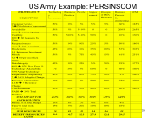
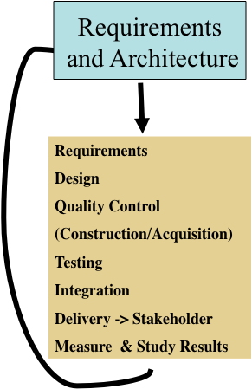

The ´Evo´ Planning Week at DoD
Monday
  Define top Ten critical objectives, quantitatively
  Agree that thee are the main points of the effort/project
Tuesday
  Define roughly the top ten most powerful strategies
  for enabling us to reach our objectives on time
Wednesday
  Make an Impact Estimation Table for Objectives/Strategies
  Sanity Test: do we seem to have enough powerful strategies to get to our Goals, with a reasonable safety margin?
  A tool for decomposing the value steps and seeing best value for resources
Thursday
  Divide into rough delivery steps (annual, quarterly)
  Derive a delivery step for ‘Next Week’
Friday
  Present these plans to approval manager (Brigadier General Pellicci)
  get approval to deliver next week
  (they can´t resist results next week!
Notes:
Added to Evo slides by TG April 8 2008 Krakow
http://a52.g.akamaitech.net/f/52/827/1d/www.space.com/template_images/top10/spc_top10_mainimg_440.jpg
http://farm2.static.flickr.com/1236/1373197020_6eab10997a_o.jpg

Slide 52
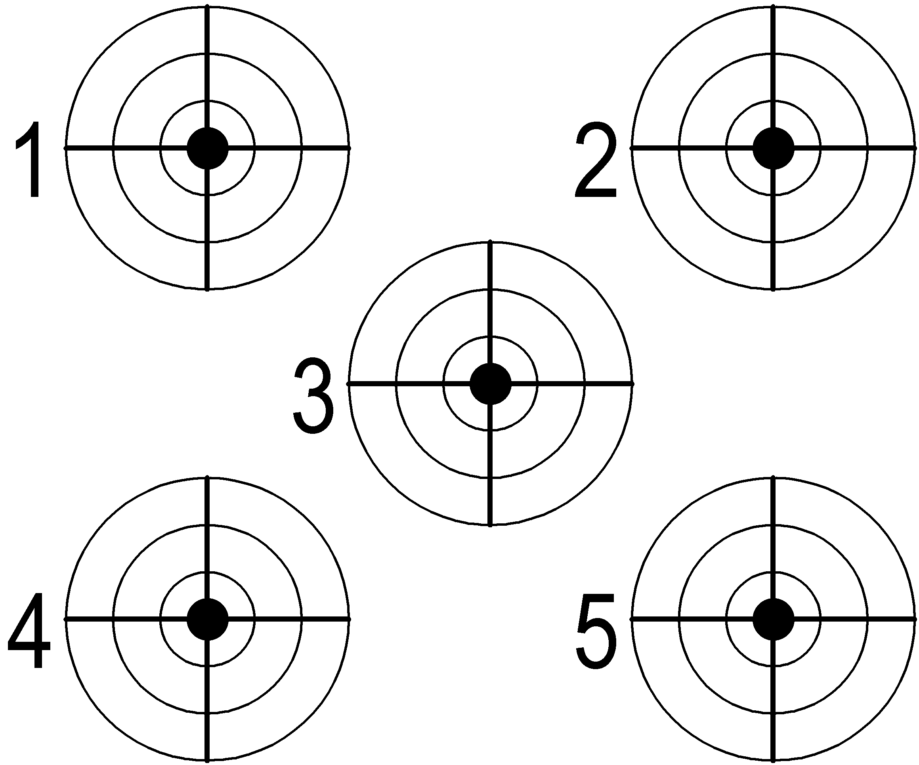
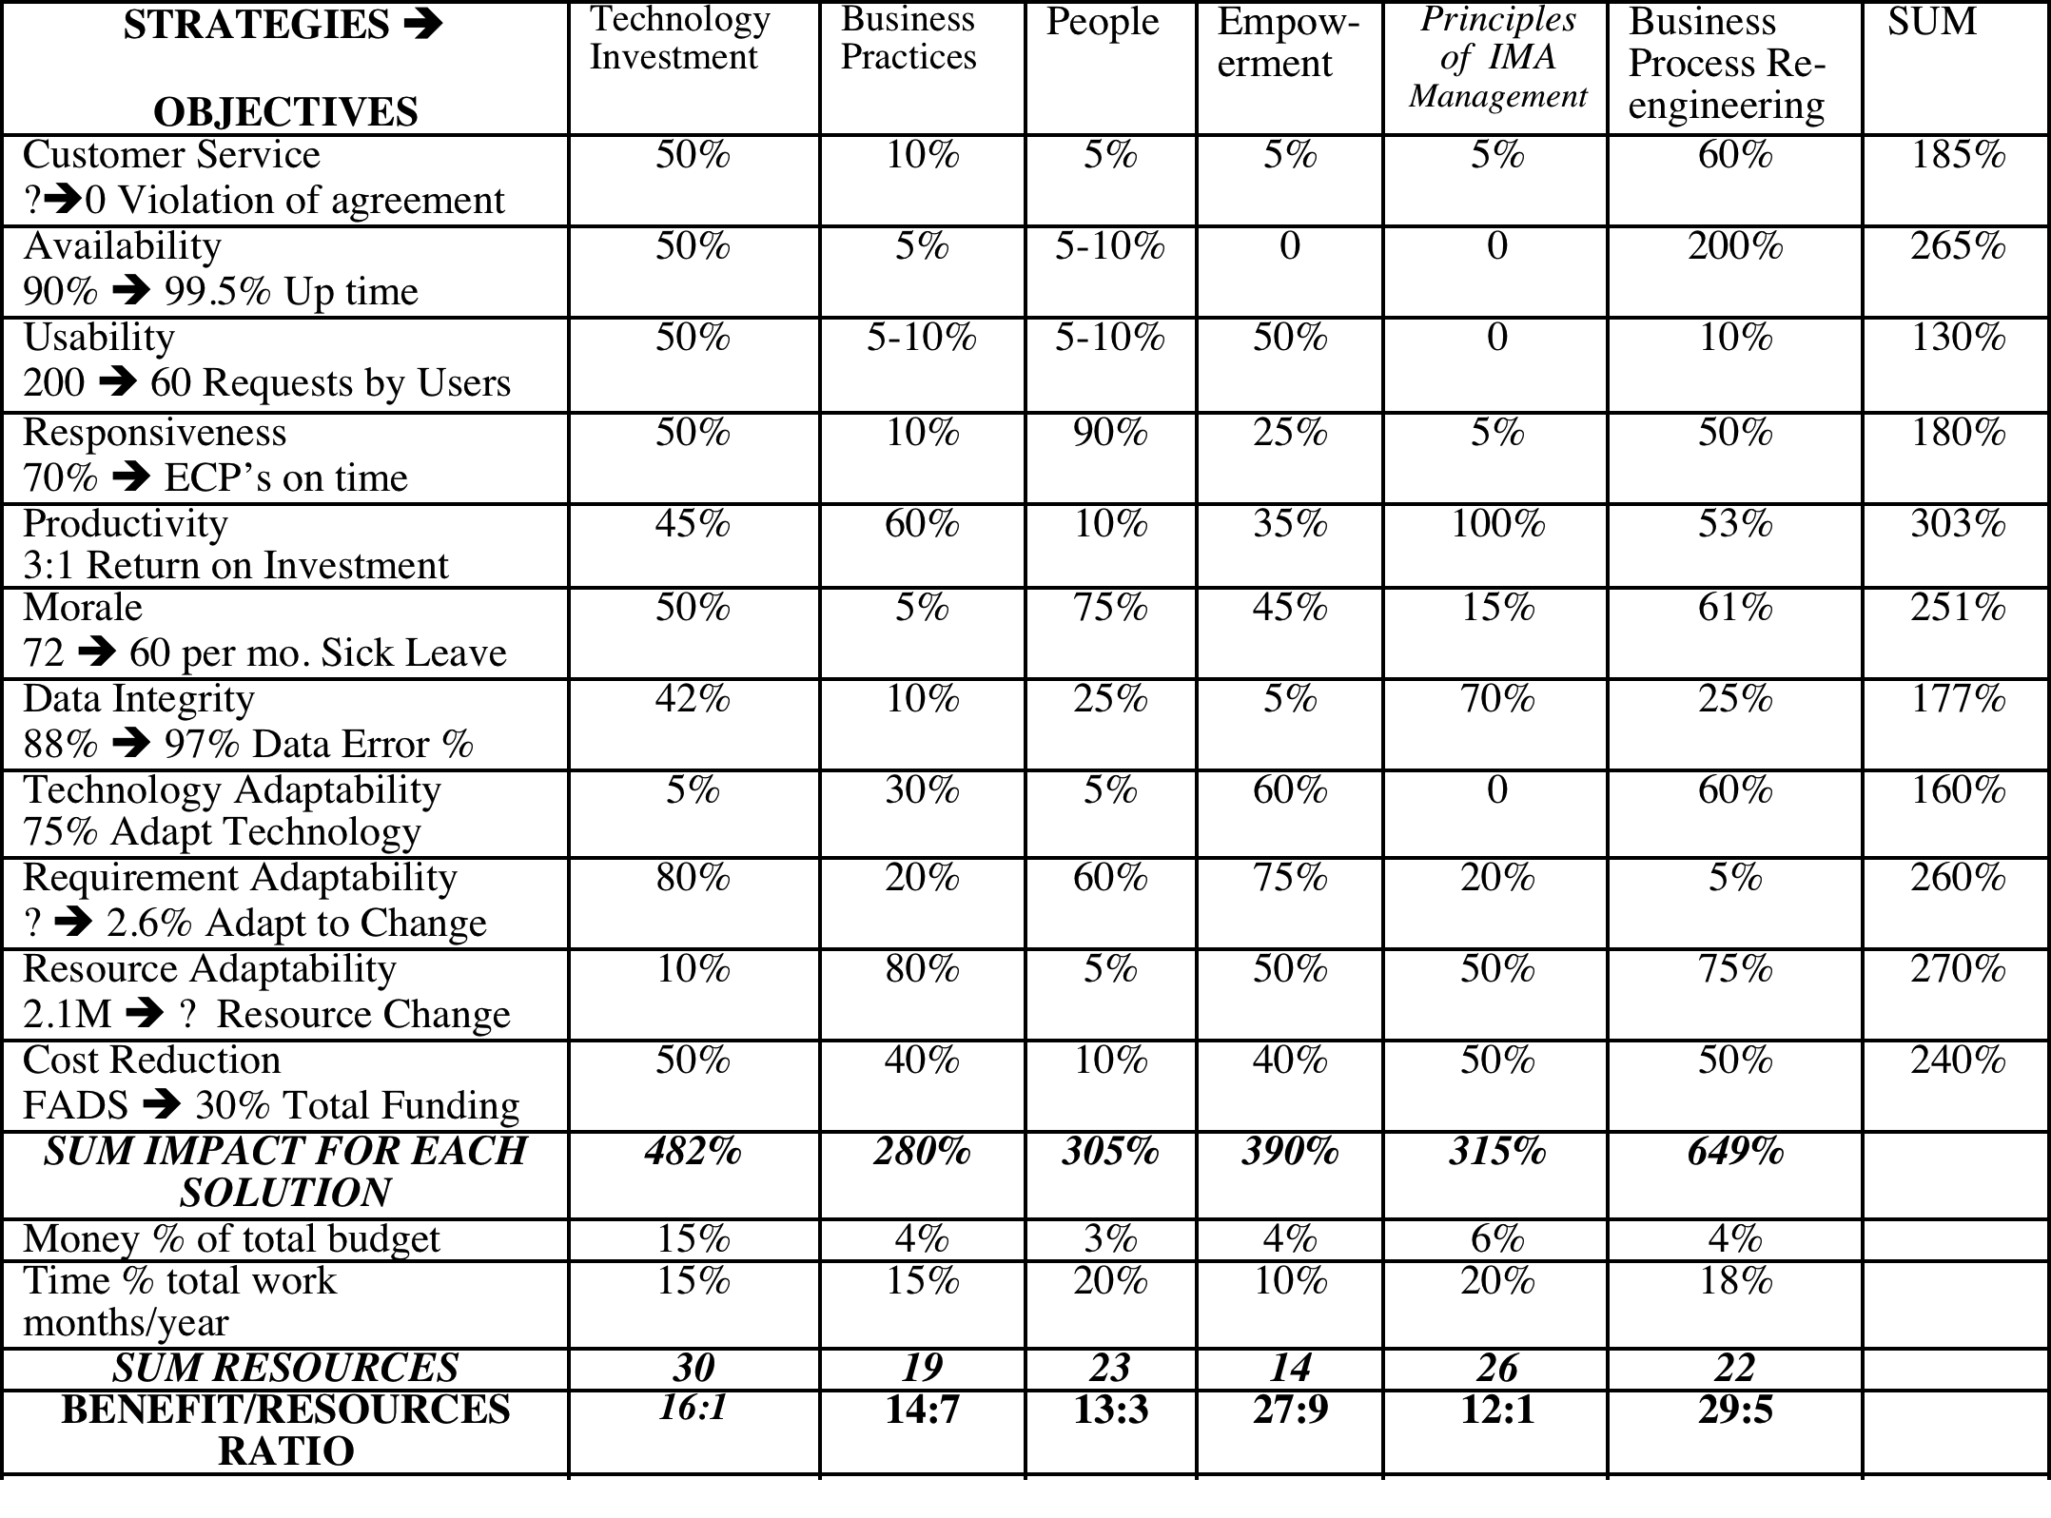
US Army Example: PERSINSCOM: Personnel System
Monday
←The Top Ten
Critical Objectives
Were decided

Slide 53
Sample of Objectives/Strategy definitions
US Army Example: PERSINSCOM: Personnel System
Example of one of the Objectives:
Customer Service:
Type: Critical Top level Systems Objective
Gist: Improve customer perception of quality of service provided.
Scale: Violations of Customer Agreement per Month.
Meter: Log of Violations.
Past [Last Year] Unknown Number ⬅State of PERSCOM Management Review
Record [NARDAC] 0 ? ⬅ NARDAC Reports Last Year
Fail : <must be better than Past, Unknown number> ⬅CG
Goal [This Year, PERSINCOM] 0 “Go for the Record” ⬅ Group SWAG
.

Slide 54

US Army Example: PERSINSCOM: Personnel System
Tuesday
The Top Ten
Critical Strategies
For reaching the
←objectives
Were decided

Slide 55
Sample of Objectives/Strategy definitions
US Army Example: PERSINSCOM: Personnel System
A Strategy (Top Level of Detail)
Technology Investment:
Gist: Exploit investment in high return technology.
Impacts: productivity, customer service and conserves resources.

Slide 56
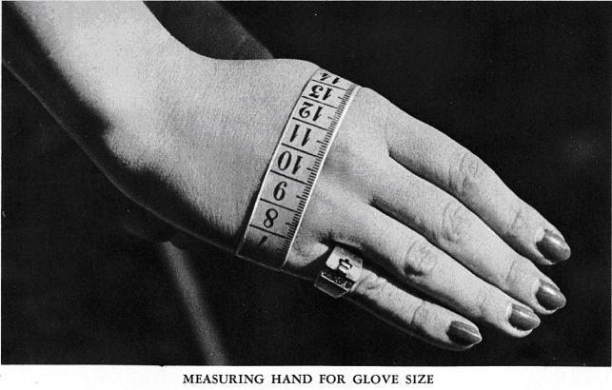
Wednesday: Sanity Check
Day 3 of 5 of ‘Feasibility Study
We made a rough evaluation
  of how powerful our strategies might be
  in relation to our objectives
Impact Estimation Table
  0% Neutral, no ± impact
  100% Gets us to Goal level on time
  50% Gets us half way to Goal at deadline
  -10% has 10% negative side effect
Notes:
http://vintagesewing.info/1950s/50-hmg/hmg-02.html

Slide 57
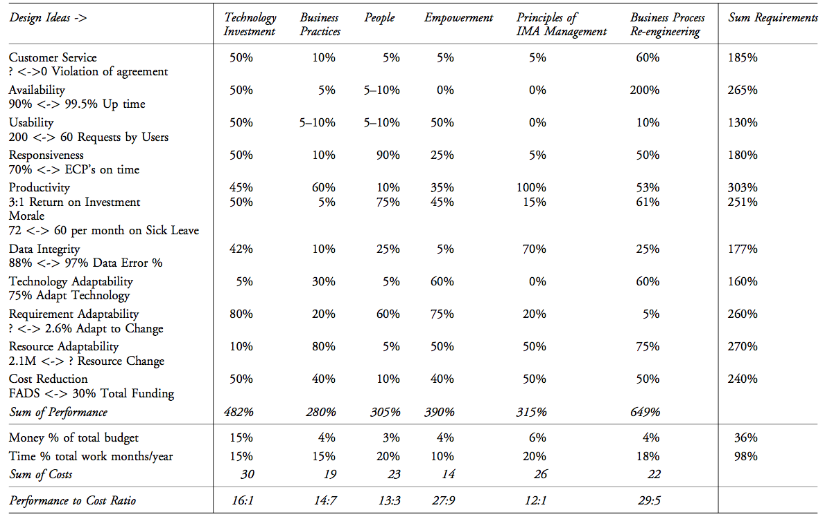
Persinscom Impact Estimation Table:
Designs
Requirements
R→ D Impacts
Notes:
Source CE book page 284. Persinscom US Army Personnel System.

Slide 58
Impact Estimation: Value-for-Money Delivery Table

Slide 59
Thursday:
Day 4 of 5 of ‘Feasibility Study
We looked for a way to deliver some stakeholder results, next week
1 1 1 1 1 1 Unity
  1% increase at least
  1 stakeholder
  1 quality/value
  1 week delivery cycle
  1 function focus
  1 design used
Notes:
http://vintagesewing.info/1950s/50-hmg/hmg-02.html

Slide 60

Next weeks Evo Step?
“You won’t believe we never thought of this, Tom!’
The step:
  When the Top General Signs in
  Move him to the head of the queue
    of all people inquiring on the system.
Notes:
Added April 8 2008 Krakow TG
http://www.picturehistory.com/images/products/1/3/0/prod_13087.jpg

Slide 61
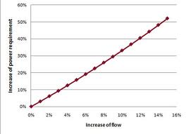




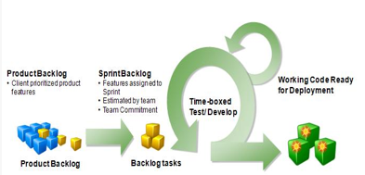
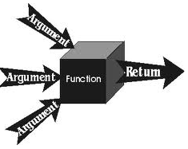

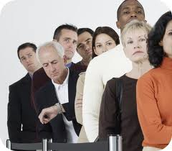
1 1 1 1 1 1 Unity
  1% increase at least
  1 stakeholder
  1 quality or value
  1-week delivery cycle
  1 function focus
  1 design used

Slide 62
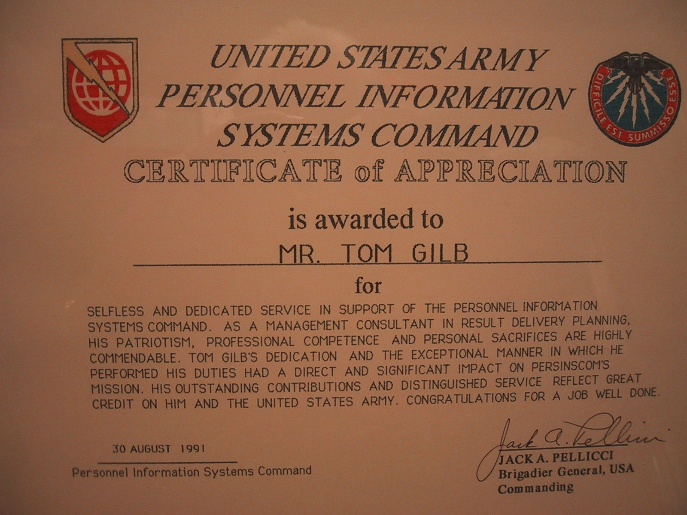
“I kill men for a living! ( General Pellicci)

Slide 63
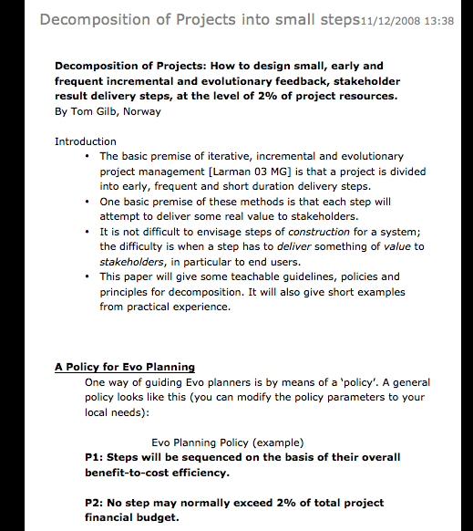

Decomposition Principles
A Teachable Discipline
How to decompose systems into small evolutionary steps:
some principles to apply:
1• Believe there is a way to do it, you just have not found it yet!
2• Identify obstacles, but don't use them as excuses: use your imagination to get rid of them!
3• Focus on some usefulness for the user or customer, however small.
4• Do not focus on the design ideas themselves, they are distracting, especially for small initial cycles. Sometimes you have to ignore them entirely in the short term!
5• Think; one customer, tomorrow, one interesting improvement.
6• Focus on the results (which you should have defined in your goals, moving toward target levels).
7• Don't be afraid to use temporary-scaffolding designs. Their cost must be seen in the light of the value of making some progress, and getting practical experience.
8• Don't be worried that your design is inelegant; it is results that count, not style.
9• Don't be afraid that the customer won't like it. If you are focusing on results they want, then by definition, they should like it. If you are not, then do!
10• Don't get so worried about "what might happen afterwards" that you can make no practical progress.
11• You cannot foresee everything. Don't even think about it!
12• If you focus on helping your customer in practice, now, where they really need it, you will be forgiven a lot of ‘sins’!
13• You can understand things much better, by getting some practical experience (and removing some of your fears).
14• Do early cycles, on willing local mature parts of your user community.
15• When some cycles, like a purchase-order cycle, take a long time, initiate them early, and do other useful cycles while you wait.
16• If something seems to need to wait for ‘the big new system’, ask if you cannot usefully do it with the ‘awful old system’, so as to pilot it realistically, and perhaps alleviate some 'pain' in the old system.
17• If something seems too costly to buy, for limited initial use, see if you can negotiate some kind of ‘pay as you really use’ contract. Most suppliers would like to do this to get your patronage, and to avoid competitors making the same deal.
18• If you can't think of some useful small cycles, then talk directly with the real ‘customer’ or end user. They probably have dozens of suggestions.
19• Talk with end users in any case, they have insights you need.
20• Don't be afraid to use the old system and the old ‘culture’ as a launching platform for the radical new system. There is a lot of merit in this, and many people overlook it.
I have never seen an exception in 33 years of doing this with many varied cultures. Oh Ye of little faith!
http://www.gilb.com/tiki-download_file.php?fileId=41
Notes:
Decomposition of Projects: How to Design Small Incremental Steps INCOSE 2008
http://www.gilb.com/tiki-download_file.php?fileId=41
http://www.gilb.com/tiki-download_file.php?fileId=350
Decomposition Slides Aug 2010

Slide 64
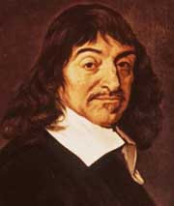
Rene Descartes on Focus
“We should bring the whole force of our minds
  to bear upon the most minute and simple details
  and to dwell upon them for a long time
  so that we become accustomed to perceive the truth clearly and distinctly.”
Rene Descartes, Rules for the Direction of the Mind, 1628
Notes:
Added January 5 2003 TG from quotations from Ben Shneiderman
url www.cals.ncsu.edu for Descartes
Rene Descartes was a mediocre scientist, a great mathematician and an even greater philosopher. He is considered to be the father of modern philosophy. His thought affected educational theory in the following manner:
1. EDUCATION A NATURAL RIGHT OF MAN. Since knowledge is attained through the reasoning processes, every man has the right to develop the innate faculties of his soul. Although men learn at different paces, education is possible for all.
2. IMPORTANCE OF DOUBTING AUTHORITATIVE PROPOSITIONS. It is necessary for man to doubt everything prior to asserting any definite truths. This act of doubt leads the mind to the rational assertion of a self-evident principle that cannot be doubted. Therefore, it is possible to infer the right of each man to think for himself.
3. CLEAR AND CERTAIN TRUTHS. Man ought to accept no statement as true, unless it appears clear and certain to his intellect.
4. PSYCHOLOGICAL PRINCIPLES OF KNOWLEDGE. In the act of knowing, the mind proceeds from what is already known to the unknown, This infers the need for a teacher to base learning upon the intellectual experience of each pupil. Descartes asserted the principle that the mind moves from the concrete to the abstract, the simple to the more complex. These principles underlie the organization of

Slide 65
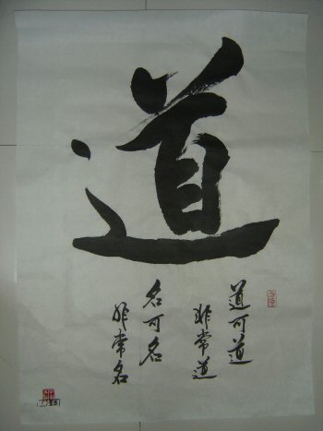
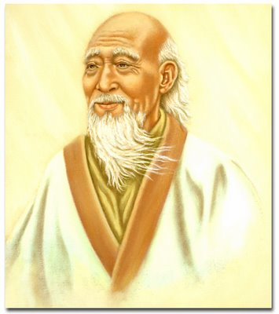
Tao Te Ching (500BC)
That which remains quiet, is easy to handle.
That which is not yet developed is easy to manage.
That which is weak is easy to control.
That which is still small is easy to direct.
Deal with little troubles before they become big.
Attend to little problems before they get out of hand.
  For the largest tree was once a sprout,
the tallest tower started with the first brick,
and the longest journey started with the first step.
  From Lao Tzu in Bahn, 1980 (also quoted in Gilb, Principles of Software Engineering Management page 96), Penguin book
Notes:
lao_tzu_tao_te_ching.jpg
355 × 400 - Tao Te Ching ...
bodymindheartspirit.ning.com
Similar ‑ More sizes
Website for this image
edepot.com
daodejing1.jpg
350 × 467 - Tao and First Line of Tao Te Ching
edepot.com

Slide 66
What new useful things did your learn?

Slide 67
What Problems do you see in implementing these ideas in practice

Slide 68
What advice would you give to your managers as a result of this

Slide 69
What should be our Policies regarding product development

Slide 70
What are you going to do next week of any of this?

Slide 71
End of ‘Learning by Doing’

Slide 72
Case Studies

Slide 73





Value Management (Evo) with
Scrum development
developing a large web portal www.bring.no dk/se/nl/co.uk/com/ee
at Posten Norge
Copyright: Kai@Gilb.com
73
Slides download: http://bit.ly/BringCase

Slide 74
We have a challenge ...
Notes:
Do you know what the problem is?
is it? tools? management?
would you like Management to embrace Agile?
Listen up!
Why difficult for managers?
Is there anything, in say Scrum, that even tries to address the promise of results to stakeholders, business results, stakeholder value results.
How much! of what values! To whom! to what costs?
We have a problem Agileists! We have a problem Scrum Masters! We have a problem Product Owners!
Do you know what the problem is?
What is your main problem with Agile development?
Is your main problem with development? Probably not!
Is your main problem with tools?
Is your main problem with higher level management? Yes? Do they understand what we are doing?
Would you like Management to understand Agile?
Would you like them to support you more?
Would you like them to participate from their side?
Would you like management to embrace Agile development?
Listen up!
Why is it difficult for Management to embrace agile?
Why is it difficult for Management to embrace Agile?
Is Agile difficult to understand? No it has simple prescriptive recipes like Scrum.
Management cant get a grip on, and I would say rightly so;
How they can manage the end results, that development, agile or not, is there to give them.
The value benefits it will give their customers, their stakeholders
What it will cost, when it will be done.
Is there anything, in say Scrum, that even tries to address the promise of results to stakeholders, business results, stakeholder value results.
How much! of what values! To whom! to what costs?
If you can not communicate that to a manager, you don't deserve his ears!
Do you deserve his ears?

Slide 75
deliver value to stakeholders, within agreeable resources.

Slide 76
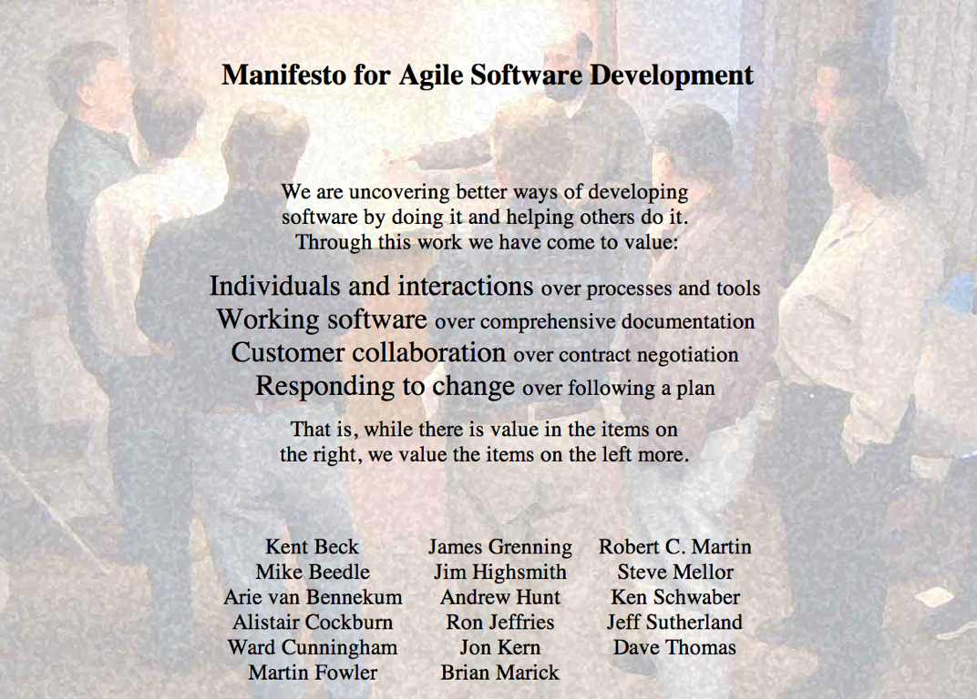

no external Value delivery?
not even a thought about Stakeholders?
It is all about YOU
“You, the developer, have become the center of the universe!”
<- Scott Ambler
Notes:
Scot

Slide 77

In astronomy, the geocentric model or the Ptolemaic worldview of the universe is the superseded theory that
the Earth is the center of the universe and other objects go around it.
Belief in this system was common in ancient Greece. It was embraced by both Aristotle (see Aristotelian physics) and Ptolemy, and most, but not all, Ancient Greek philosophers assumed that the Sun, Moon, stars, and naked eye planets circle the Earth. Similar ideas were held in ancient China.
<Source- http://en.wikipedia.org/wiki/Geocentric_model
Notes:
heavenly bodies — An illustration of the Ptolemaic geocentric system by Portuguese cosmographer and cartographer Bartolomeu Velho, 1568 (Bibliotèque National, Paris)
Is that how we see the world?

Slide 78
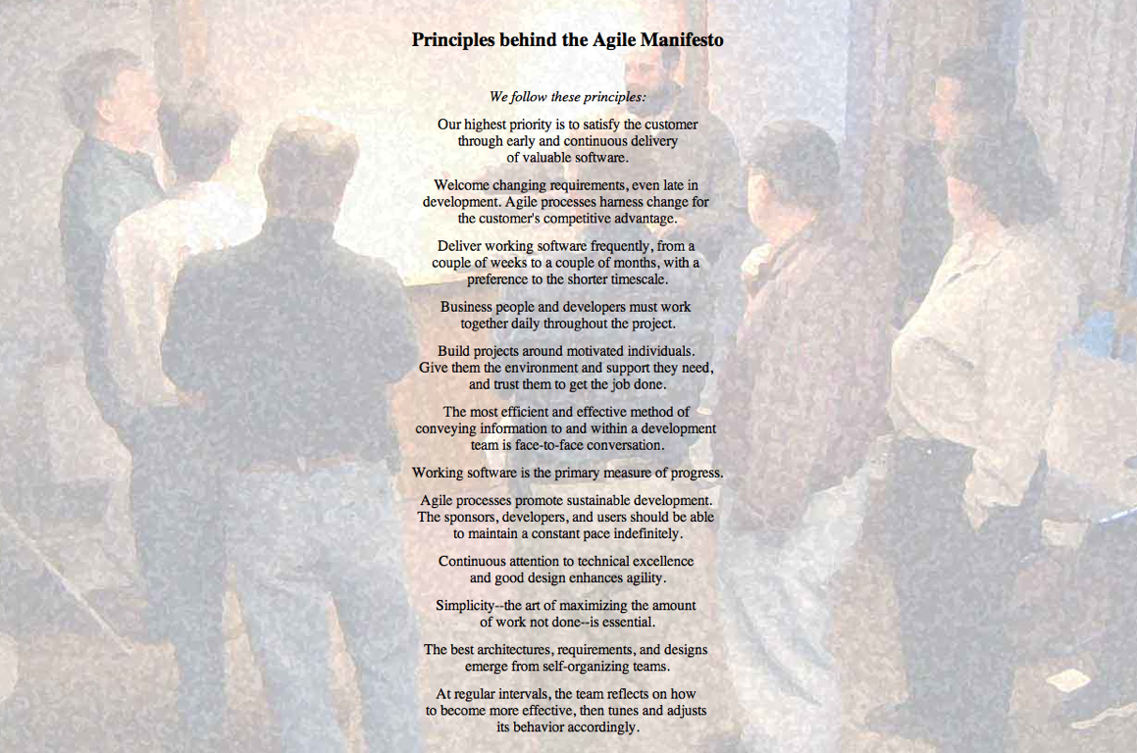
Our highest priority is to satisfy the customer
through early and continuous delivery
of valuable software.
Working software is the primary measure of progress.

Slide 79
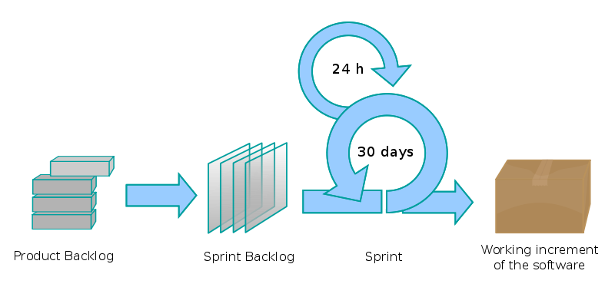
Scrum
Copyright: Kai@Gilb.com
79
Notes:
Our highest priority is to satisfy the customer
through early and continuous delivery
of valuable software.
Good luck !!!

Slide 80

deliver value to stakeholders, within agreeable resources.
Should we not try to
understand and define
what our stakeholders value?
And set out to deliver that!
Our highest priority is to satisfy the customer
through early and continuous delivery
of valuable software.
Notes:
Well that is what we do at Bring
and that is what we always do with Value Management
and I cant wait to tell you how you can do that!

Slide 81

history
Posten Norge AS bought a series of companies
  within Logistics, Package transport, CRM and Storage
  in Norway, Sweden, Denmark, Finland, UK, Holland and Estonia.
Copyright: Kai@Gilb.com
81

Slide 82
Notes:
Posten Norge AS bought a series of companies
within Logistics, Package transport, CRM and Storage
in Norway, Sweden, Denmark, Finland, UK, Holland and Estonia.

Slide 83
history
Each company had their own “everything”, including websites, with their own look, feel, functionality, logo, technologies, contracts, servers etc.
Bring.no/se/dk etc. was developed as a common webportal, replacing the many.
Copyright: Kai@Gilb.com
83

Slide 84
Notes:
Each company had their own “everything”, including websites, with their own look, feel, functionality, logo, technologies, contracts, servers etc.
Bring.no/se/dk etc. was developed as a common webportal, replacing the many.

Slide 85
Development Methods
“Normal” Management methods
Scrum development framework
Copyright: Kai@Gilb.com
85

Slide 86
Notes:
“Normal” Management methods
Scrum development framework

Slide 87
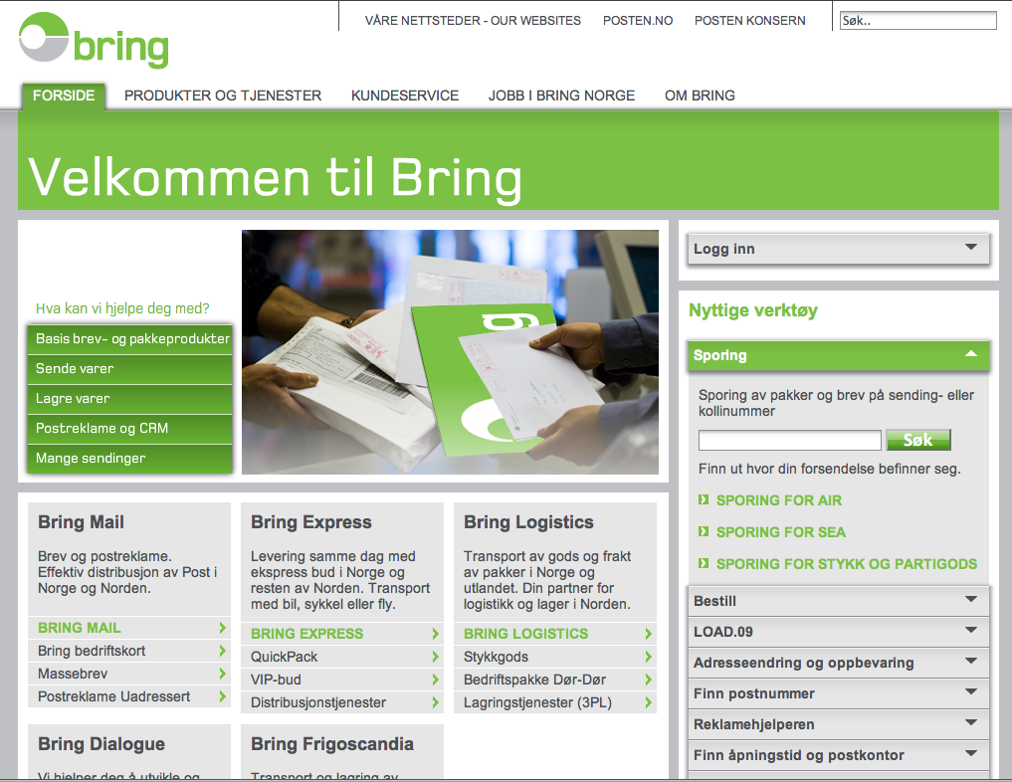

Slide 88
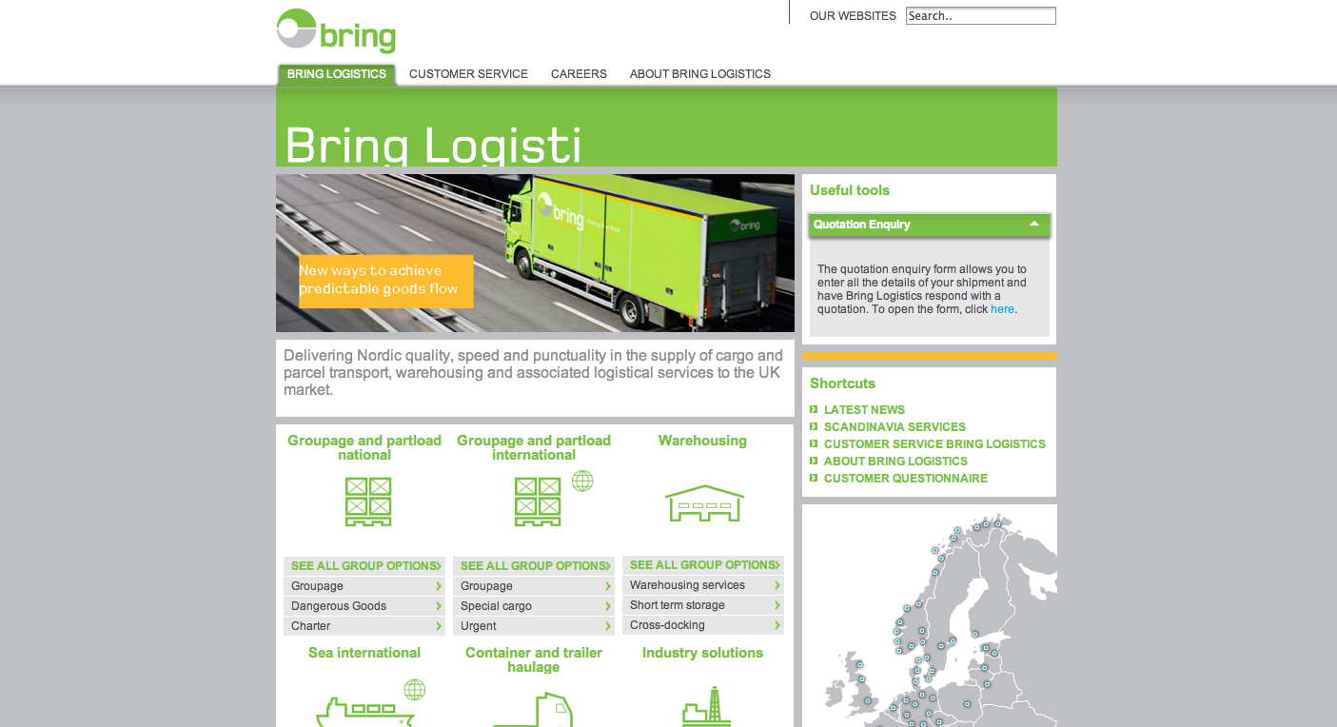

Slide 89
version 2
core functionality is in place
many nice elements
but
several business partners
are not happy with many aspects
Copyright: Kai@Gilb.com
89

Slide 90
Notes:
version 1
core functionality is in place
many nice elements but
several business partners
are not happy with many aspects

Slide 91
getting better
version 1 - put the core functionality in place.
version 2 - is about making that functionality work better for all stakeholders; Users, Business Partners etc.
Copyright: Kai@Gilb.com
91

Slide 92
Notes:
getting better
version 1 - put the core functionality in place.
version 2 - is about making that functionality work better for all stakeholders; Users, Business Partners etc.

Slide 93
Some Players
Posten
Webteam - Value Management Certified
  Project Owner: Anne Hognestad anne.hognestad@posten.no
  Product Owner: Terje Berget terje.berget@posten.no
  Lin Smitt-Amundsen & Kristin Nygård
Many Business Groups and internal stakeholders.
Kjetil Halvorsen kjetil.halvorsen@posten.no
Bekk & Ergo Group
Scrum Master: Fredrik Bach fredrik.bach@bekk.no
Technical Architect: Stefan M. Landrø: stefan.landro@bekk.no
Graphics: Espen Satver
Morten Wille Johannessen, Markus Krüger, Dag Stepanenko
NetLife Research
User Experience: Gjermund Also gjermund@netliferesearch.com Kjell-Morten Bratsberg Thorsen
Kai Gilb: Management Coach: Kai
Copyright: Kai@Gilb.com
93

Slide 94
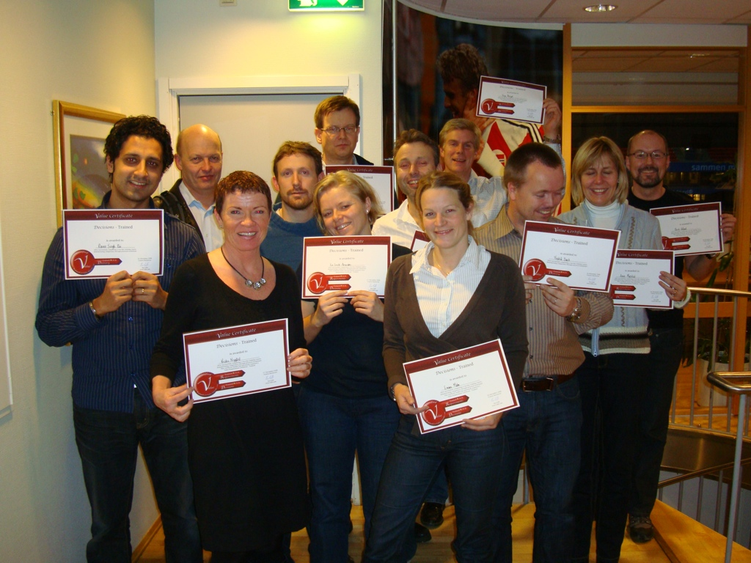
94

Slide 95
Value Management Process (Evo)
Identify Stakeholders
Specify Stakeholder Value and Product Quality Requirements
Find, Evaluate & Prioritize Solutions to satisfy Requirements.
Decompose the Solutions down into ‘weekly’ evolutionary delivery cycles.
Develop the next cycle, Deliver,
Measure, Learn, Change.
Product Owner
Scrum
Copyright: Kai@Gilb.com

Slide 96


Learn
Stakeholders
Measure
Values
Value Management
Process
Deliver
Solutions
Develop
Decompose
Copyright: Kai@Gilb.com
96

Slide 97
Learn
Stakeholders
Measure
Values
Identify Stakeholders
Who and what cares about the outcome of our project?
Deliver
Solutions
Develop
Decompose
Copyright: Kai@Gilb.com
97

Slide 98
Learn
Stakeholders
Measure
Values
Value Capturing
Find & specify quantitatively Stakeholder Values, Product Qualities & Resource improvements.
Deliver
Solutions
Develop
Decompose
Copyright: Kai@Gilb.com
98

Slide 99
Learn
Stakeholders
Measure
Values
Solution Prioritization
Find, Evaluate & Prioritize Solutions to satisfy Requirements.
Deliver
Solutions
Develop
Decompose
Copyright: Kai@Gilb.com
99

Slide 100
Learn
Stakeholders
Measure
Values
Evo Cycles
Decompose the winning Solutions down into smaller entities,
then package them so they deliver maximum Value.
Deliver
Solutions
Develop
Decompose
Copyright: Kai@Gilb.com
100

Slide 101
Learn
Stakeholders
Measure
Values
Develop
Develop the packages that
deliver the Value.
Deliver
Solutions
Develop
Decompose
Copyright: Kai@Gilb.com
101

Slide 102
Learn
Stakeholders
Measure
Values
Deliver
Deliver to Stakeholders
improved Value.
(not always a thing or code)
Deliver
Solutions
Develop
Decompose
Copyright: Kai@Gilb.com
102

Slide 103
Learn
Stakeholders
Measure
Values
Measure Change
Measure how much the Values changed.
Deliver
Solutions
Develop
Decompose
Copyright: Kai@Gilb.com
103

Slide 104
Learn
Stakeholders
Measure
Values
Learn & Change
Learning is defined as a change in behavior.
Deliver
Solutions
Develop
Decompose
Copyright: Kai@Gilb.com
104

Slide 105
Learn
Stakeholders
Measure
Values
Value Management
Process
Deliver
Solutions
Develop
Decompose
Copyright: Kai@Gilb.com
105

Slide 106
Learn
Stakeholders
Measure
Values
Value Management
Process
Scrum
Deliver
Solutions
Develop
Decompose
Copyright: Kai@Gilb.com
106
Copyright: Kai@Gilb.com

Slide 107
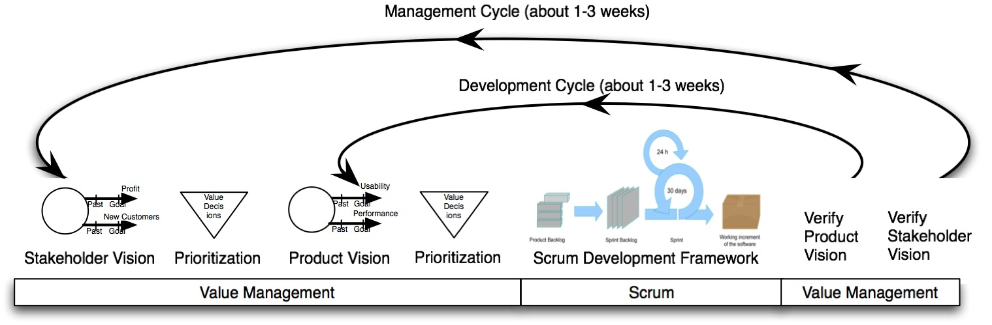
Value Management
Copyright: Kai@Gilb.com
107
Notes:
Verdi styrings teknikker inn og ut av scrum

Slide 108
Value Management
Developers
Developers
Management
Management
Copyright: Kai@Gilb.com
108

Slide 109
Value Management
Copyright: Kai@Gilb.com
109

Slide 110
Value Decision Tables
Business Goals | Stakeholder Value 1 | Stakeholder Value 2
Business Value 1 | -10% | 40%
Business Value 2 | 50% | 10%
Resources | 20% | 10%
Stakeholder Val. | Product Value 1 | Product Value 2
Stakeholder Value 1 | -10% | 50 %
Stakeholder Value 2 | 10 % | 10%
Resources | 2 % | 5 %
Product Values | Solution 1 | Solution 2
Product Value 1 | -10% | 40%
Product Value 2 | 50% | 80 %
Resources | 1 % | 2 %
Prioritized List
1. Solution 2
2. Solution 9
3. Solution 7
Scrum Develops
We measure improvements
Learn and Repeat
Prioritized List
1. Solution 2
2. Solution 9
3. Solution 7
Copyright: Kai@Gilb.com

Slide 111
Value Decision Tables
Product Values | Solution 1 | Solution 2
Product Value 1 | -10% | 40%
Product Value 2 | 50% | 80 %
Resources | 1 % | 2 %
Copyright: Kai@Gilb.com

Slide 112
Value Decision Tables
Product Values | Solution 1 | Solution 2
Product Value 1
Product Value 2
Resources
Copyright: Kai@Gilb.com

Slide 113

Value Decision Tables
Product Values
Product Value 1
Product Value 2
Resources
Copyright: Kai@Gilb.com

Slide 114

Value Decision Tables
Product Values
Product Value 1
Product Value 2
Resources
Copyright: Kai@Gilb.com

Slide 115
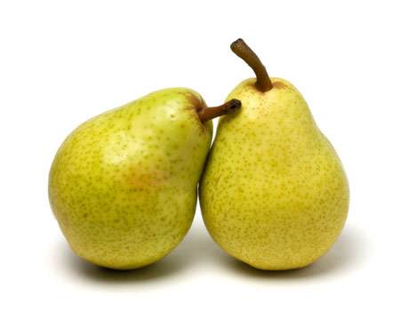
Value Decision Tables
Product Values
Product Value 1
Product Value 2
Resources
Copyright: Kai@Gilb.com

Slide 116
Value Decision Tables
Product Values
Taste
Resources
Copyright: Kai@Gilb.com

Slide 117
Value Decision Tables
Product Values
Taste
Nutrition
Resources
Copyright: Kai@Gilb.com

Slide 118
Value Decision Tables
Product Values
Taste
Nutrition
Shelf Life
Resources
Copyright: Kai@Gilb.com

Slide 119
Value Decision Tables
Product Values
Taste
Nutrition
Shelf Life
Sum Goodies
Resources
Copyright: Kai@Gilb.com

Slide 120


Value Decision Tables
Product Values
Taste
Nutrition
Shelf Life
Sum Goodies
Resources
20 % | 50 % | 90 %
30 % | 70 % | 90 %
80 % | 30 % | -10 %
130 % | 150 % | 170 %
40 % | 60 % | 80 %
Copyright: Kai@Gilb.com

Slide 121
Value Decision Tables
Product Values
Taste
Nutrition
Shelf Life
Sum Goodies
Resources
20 % | 50 % | 90 %
30 % | 70 % | 90 %
80 % | 30 % | -10 %
130 % | 150 % | 170 %
40 % | 60 % | 80 %
Copyright: Kai@Gilb.com

Slide 122
Value Decision Tables
Product Values | Solution 1 | Solution 2
Product Value 1 | -10 % | 40 %
Product Value 2 | 50 % | 80 %
Resources | 1 % | 2 %
Copyright: Kai@Gilb.com

Slide 123
Value Decision Tables
Business Goals | Training Costs | User Productivity
Profit | -10% | 40%
Market Share | 50% | 10%
Resources | 20% | 10%
Stakeholder Val. | Intuitiveness | Performance
Training Costs | -10% | 50 %
User Productivity | 10 % | 10%
Resources | 2 % | 5 %
Product Values | GUI Style Rex | Code Optimize
Intuitiveness | -10% | 40%
Performance | 50% | 80 %
Resources | 1 % | 2 %
Prioritized List
1. Code Optimize
2. Solution 9
3. Solution 7
Scrum Develops
We measure improvements
Learn and Repeat
Copyright: Kai@Gilb.com

Slide 124
Value Decision Tables
Training Costs
User Productivity
Business Goals
 | -10 % | 40 %
 | 50 % | 10 %
Resources | 20 % | 10 %
Profit
Market Share
Stakeholder Val. | Intuitiveness | Performance
 | -10 % | 50 %
 | 10 % | 10 %
Resources | 2 % | 5 %
Product Values | GUI Style Rex | Code Optimize
Intuitiveness | -10 % | 40 %
Performance | 50 % | 80 %
Resources | 1 % | 2 %
Prioritized List
1.
2. Solution 9
3. Solution 7
Copyright: Kai@Gilb.com

Slide 125
Value Decision Tables
Training Costs
User Productivity
Business Goals | Training Costs | User Productivity
 | -10% | 40%
 | 50% | 10%
Resources | 20% | 10%
Profit
Market Share
Stakeholder Val. | Intuitiveness | Performance
 | -10 % | 50 %
 | 10 % | 10 %
Resources | 2 % | 5 %
Product Values | GUI Style Rex | Code Optimize
Intuitiveness | -10 % | 40 %
Performance | 50 % | 80 %
Resources | 1 % | 2 %
Prioritized List
1.
2. Solution 9
3. Solution 7
Copyright: Kai@Gilb.com

Slide 126
Value Decision Tables
Business Goals | Training Costs | User Productivity
 | -10% | 40%
 | 50% | 10%
Resources | 20% | 10%
Profit
Market Share
Intuitiveness
Performance
Stakeholder Val.
 | -10 % | 50 %
 | 10 % | 10 %
Resources | 2 % | 5 %
Training Costs
User Productivity
Product Values | GUI Style Rex | Code Optimize
Intuitiveness | -10 % | 40 %
Performance | 50 % | 80 %
Resources | 1 % | 2 %
Prioritized List
1.
2. Solution 9
3. Solution 7
Copyright: Kai@Gilb.com

Slide 127
Value Decision Tables
Business Goals | Training Costs | User Productivity
 | -10% | 40%
 | 50% | 10%
Resources | 20% | 10%
Profit
Market Share
Intuitiveness
Performance
Stakeholder Val. | Intuitiveness | Performance
 | -10 % | 50 %
 | 10 % | 10 %
Resources | 2 % | 5 %
Training Costs
User Productivity
GUI Style Rex
Code Optimize
Product Values | GUI Style Rex | Code Optimize
Intuitiveness | -10 % | 40 %
Performance | 50 % | 80 %
Resources | 1 % | 2 %
Prioritized List
1.
2. Solution 9
3. Solution 7
Copyright: Kai@Gilb.com

Slide 128
Value Decision Tables
Business Goals | Training Costs | User Productivity
 | -10% | 40%
 | 50% | 10%
Resources | 20% | 10%
Profit
Market Share
Stakeholder Val. | Intuitiveness | Performance
 | -10 % | 50 %
 | 10 % | 10 %
Resources | 2 % | 5 %
Training Costs
User Productivity
GUI Style Rex
Code Optimize
Product Values | GUI Style Rex | Code Optimize
Intuitiveness | -10 % | 40 %
Performance | 50 % | 80 %
Resources | 1 % | 2 %
Prioritized List
1.
2. Solution 9
3. Solution 7
Copyright: Kai@Gilb.com

Slide 129
Value Decision Tables
Business Goals | Training Costs | User Productivity
Profit | -10% | 40%
Market Share | 50% | 10%
Resources | 20% | 10%
Stakeholder Val. | Intuitiveness | Performance
Training Costs | -10% | 50 %
User Productivity | 10 % | 10%
Resources | 2 % | 5 %
Product Values | GUI Style Rex | Code Optimize
Intuitiveness | -10% | 40%
Performance | 50% | 80 %
Resources | 1 % | 2 %
Prioritized List
1. Code Optimize
2. Solution 9
3. Solution 7
Scrum Develops
We measure improvements
Learn and Repeat
Copyright: Kai@Gilb.com

Slide 130
Value Management (Evo)
Fokus på utfordringer som ønskes løst.
Krav som formes med interessenter, som beskriver hva man ønsker forbedret, og en skala for å kunne måle forbedring fra dagens situasjon.
Kravet kvantifiserer ønsket og ”akseptabel” forbedring.
Matrise som viser hvordan krav og løsninger som påvirker hverandre.
Testing av funksjon/oppgaver både før og etter utvikling.
Et videre og mer omfattende fokus enn SCRUM
Scrum Development
Smidig utvikling, med korte iterasjonerSprint – utviklingsperioden, gjerne 2 ukerProduct backlog – Hva som ønskes utviklet over tid fra kundens ståstedSprint backlog – hva som er avtalt av utvikles i en sprint mellom kunde og leverandørScrum Master – leverandørens ProsjektlederProdukteier – Kundens deltagerDaglige Standup møter

Slide 131
examples
Copyright: Kai@Gilb.com
131

Slide 132
Learn
Stakeholders
Measure
Values
Value Capturing
Find & specify quantitatively Stakeholder Values, Product Qualities & Resource improvements.
Deliver
Solutions
Develop
Decompose
Copyright: Kai@Gilb.com
132

Slide 133

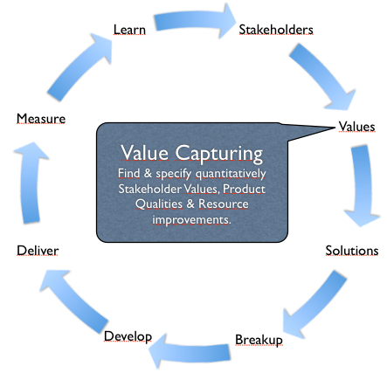
Find.Fast
Scale: average time, in seconds, a User with def. [User-Experience, default=Normal] uses to find what they and we want them to find.
Past
[Dec. 2008]
50 sec.
Tolerable
[April 2009]
40 sec.
Goal
[April 2009]
15 sec.
Copyright: Kai@Gilb.com
133

Slide 134
Find.Fast
    Versjon: 07.01.09 15.00 Type: Produkt Verdi Eier: Lin
  Interessenter: Produkteiere, Brukere, Citymail, Kunder, kunders kunder(postmottagare), Jobbsökande, Journalister, Partners, Anställda, Brukere, Citimail, Partners, Operativ-
  Skala: Gjennomsnittlig tid, i sekunder, en Bruker med def. [Bruker-Ekspertise, standardverdi Normal] bruker for å finne det de og vi ønsker at de skal finne.
    fra: def. [Startposisjon, standardverdi er foran ett blankt ark i webleseren].
    til: def. [Funnet] posisjon der informasjonen er tilstede på skjermen til Bruker, og det er registrert hos Bruker.
    Før [14.12.08, Funnet=Ukjent-Produkt] 50 sek. <- Lin/Terje ”2 bruker tester”
    Tolererbart [31.03.09, Funnet=Ukjent-Produkt] 40 sek. <- Lin/Terje
    Mål [31.03.09, Funnet=Ukjent-Produkt] 15 sek. <- Lin/Terje
  Ukjent-Produkt: def.som: korrekt Produkt, der brukeren vet hva de vil ha/gjøre, men ikke vet hvilket Produkt som kan gjøre jobben, eller ikke husker korrekt Produktnavn.
Skala: Gjennomsnittlig tid, i sekunder, en Bruker med def. [Bruker-Ekspertise, standardverdi Normal] bruker for å finne det de og vi ønsker at de skal finne.
Copyright: Kai@Gilb.com
134

Slide 136
Wargame
Copyright: Kai@Gilb.com
136

Slide 137
Learn
Stakeholders
Measure
Values
Solution Prioritization
Find, Evaluate & Prioritize Solutions to satisfy Requirements.
Deliver
Solutions
Develop
Decompose
Copyright: Kai@Gilb.com
137

Slide 138
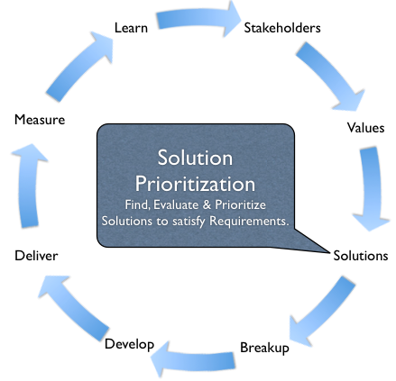
Wargame
?
Past
[Dec. 2008]
50 sec.
Tolerable
[April 2009]
40 sec.
Goal
[April 2009]
15 sec.
Copyright: Kai@Gilb.com
Notes:
The Developers (NetLife Research/Bekk) are challenged to find several solutions that can solve the challenge.
And present those ideas to Management in a Value Decision Table
with (gu)estimations about how much better things will become.

Slide 139

Wargame
And present those ideas to Management in a Value Decision Table
with (gu)estimations about how much better things will become.
Past
[Dec. 2008]
50 sec.
Tolerable
[April 2009]
40 sec.
Goal
[April 2009]
15 sec.
Copyright: Kai@Gilb.com

Slide 140
Examples of Solution submitted
Wargame
Evaluated Using Value Decision Tables
Work done by NetLife Research and Bekk
Copyright: Kai@Gilb.com
140

Slide 141

Løsningsforslag
og produkt.sammenlign
Utarbeidet av: DP Brukeropplevelse
Dato: 20.01.2009
1
04/29/09

Slide 142
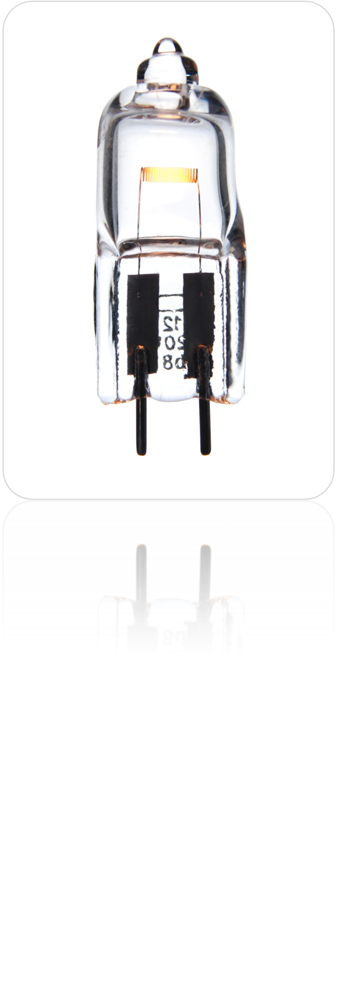
Solutions
12 solution suggestions
142

Slide 143
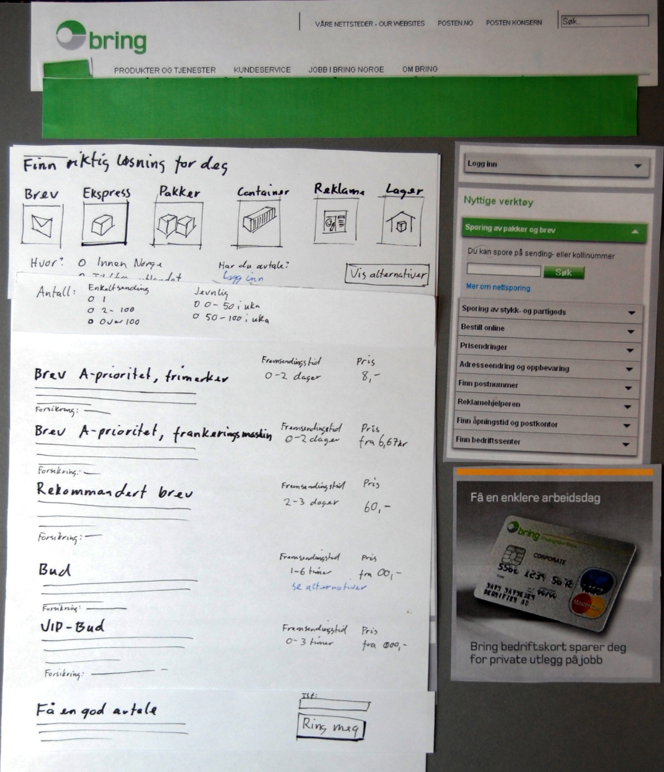
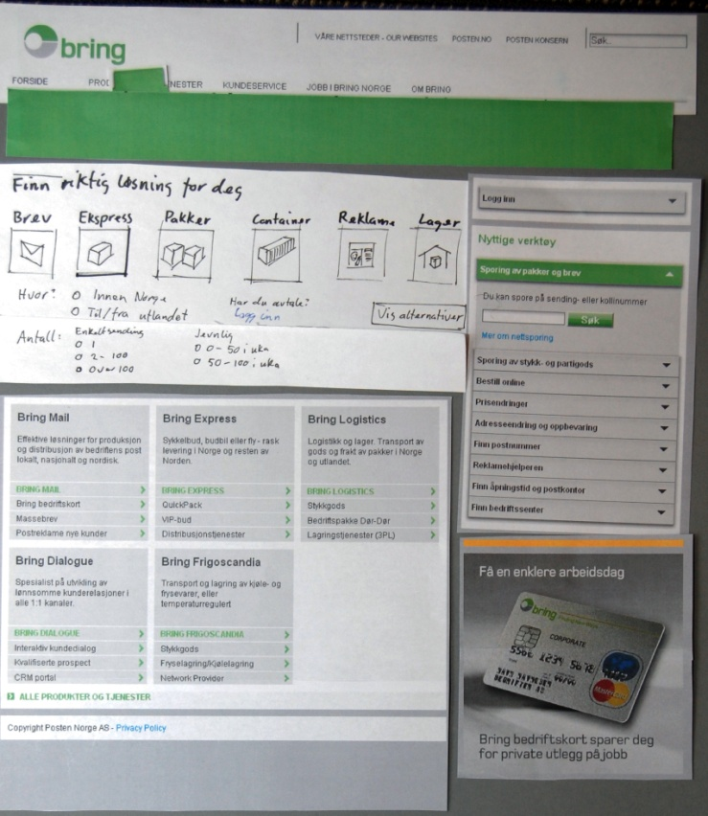

Produktveileder Wizard
1.
Produktveileder Wizard
Et dynamisk felt på forsiden spør brukerne etter deres behov på en intuitiv måte.
Resultatene en oversikt over aktuelle produkter vises. Oversikten er utformet slik at man kan sammenligne viktige produktaspekt.
(Estimatene er uten innlogging for avtalekunder)

Slide 144
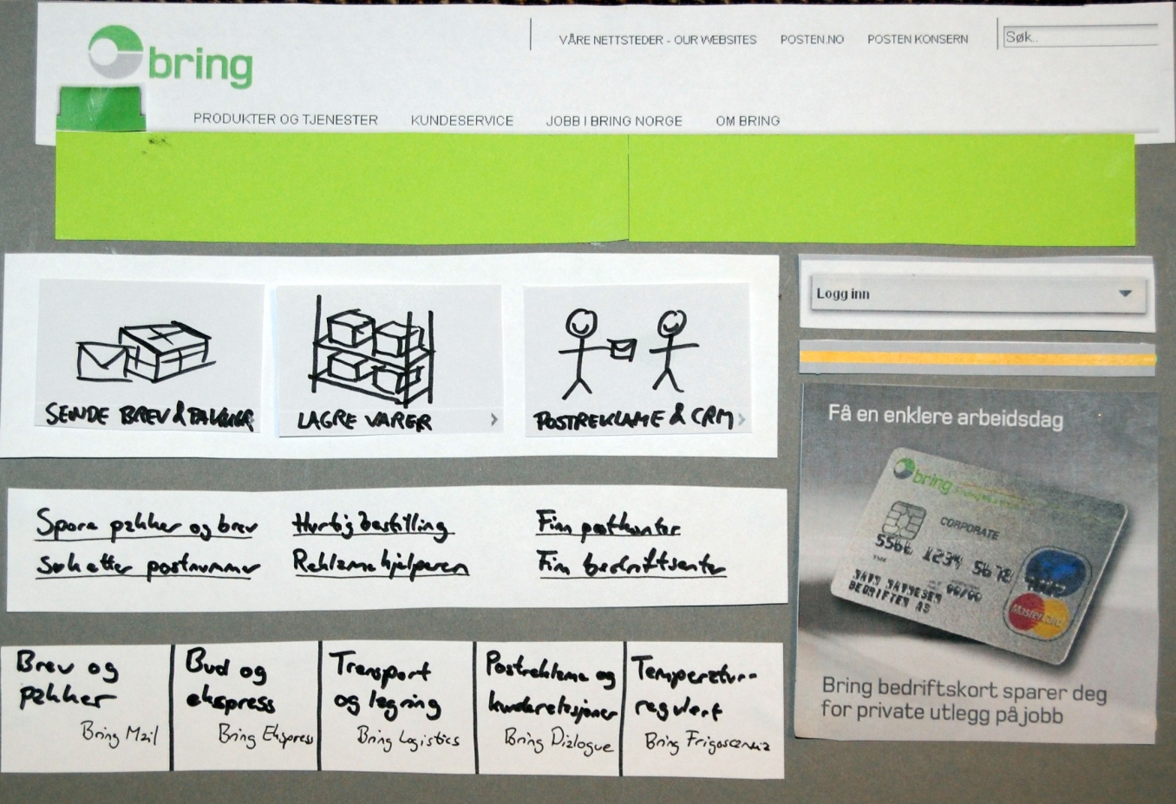


Forside
2.
Produktguide (fasettert)
9.
Flytte verktøykasse til venstre spalte
Dagens verktøykasse plasseres i midtfeltet. Det bør fortsatt være dynamiske felter brukerne kan skrive rett inn i.
8.
Behovsformulering på spesialistinnganger
”Forklaringen” gjøres om til menypunkt. Spesialistnavnet skrives under.

Slide 145
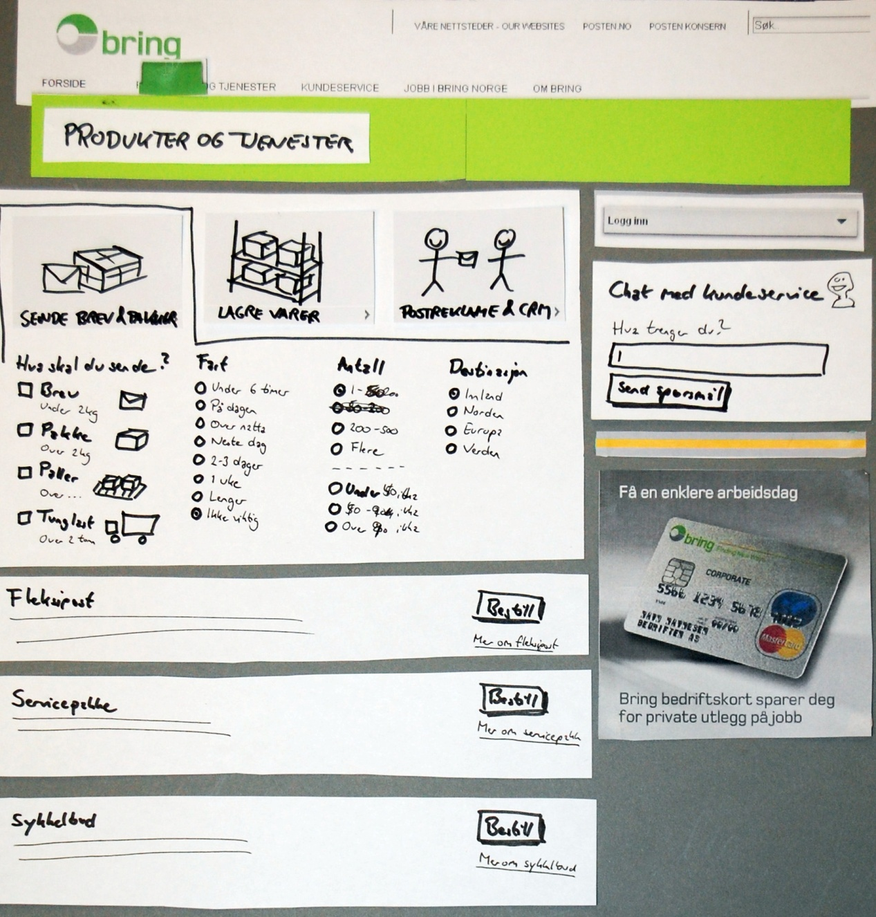
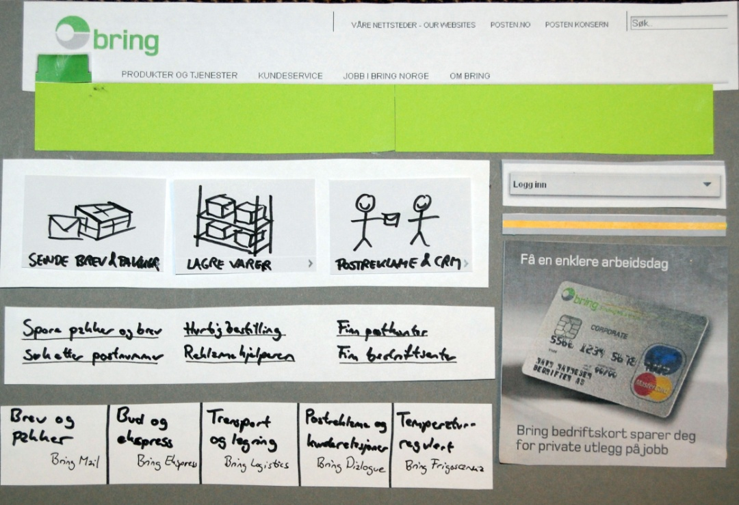
Produktguide Fasettert
2.
Produktguide fasettert
Baseres på søkemotorteknologi og søkemotormetaforer.

Slide 146
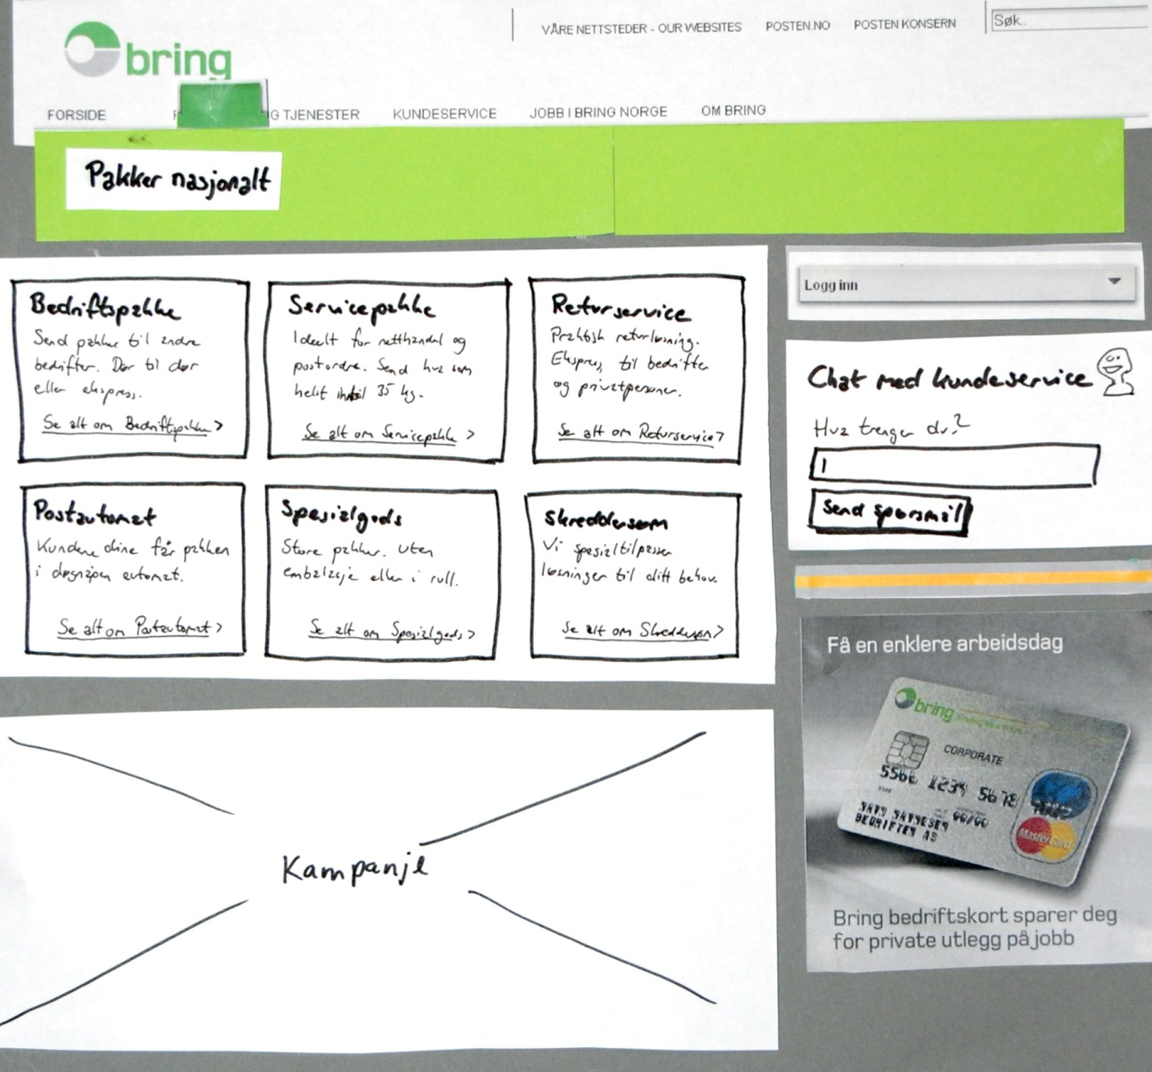

3.
Færre produkter
Presentere det som i dag er ulike produkter som alternativer på et produktark
Copyright NetLife Research - www.netliferesearch.com - kontakt@netliferesearch.comNetLife Research AS,

Slide 147
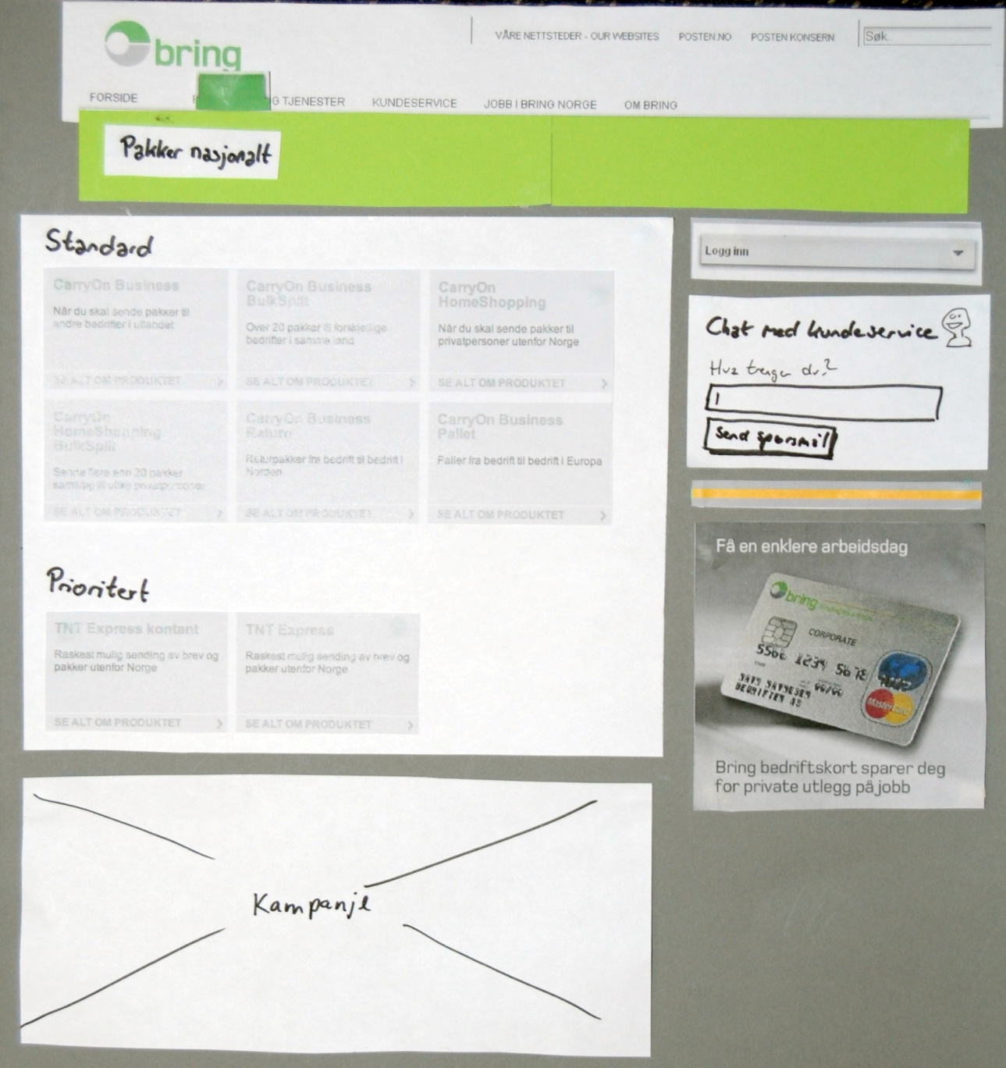

4.
Grunnere navigasjon
Slik at brukerne kommer raskere til malen produktgruppe.
Legges inn mulighet til å gi kategoriseringer på produktgruppemalen.
12.
Chat
Kundeservice svarer manuelt på hvilket produkt som passer for kunden.
Copyright NetLife Research - www.netliferesearch.com - kontakt@netliferesearch.comNetLife Research AS,

Slide 148
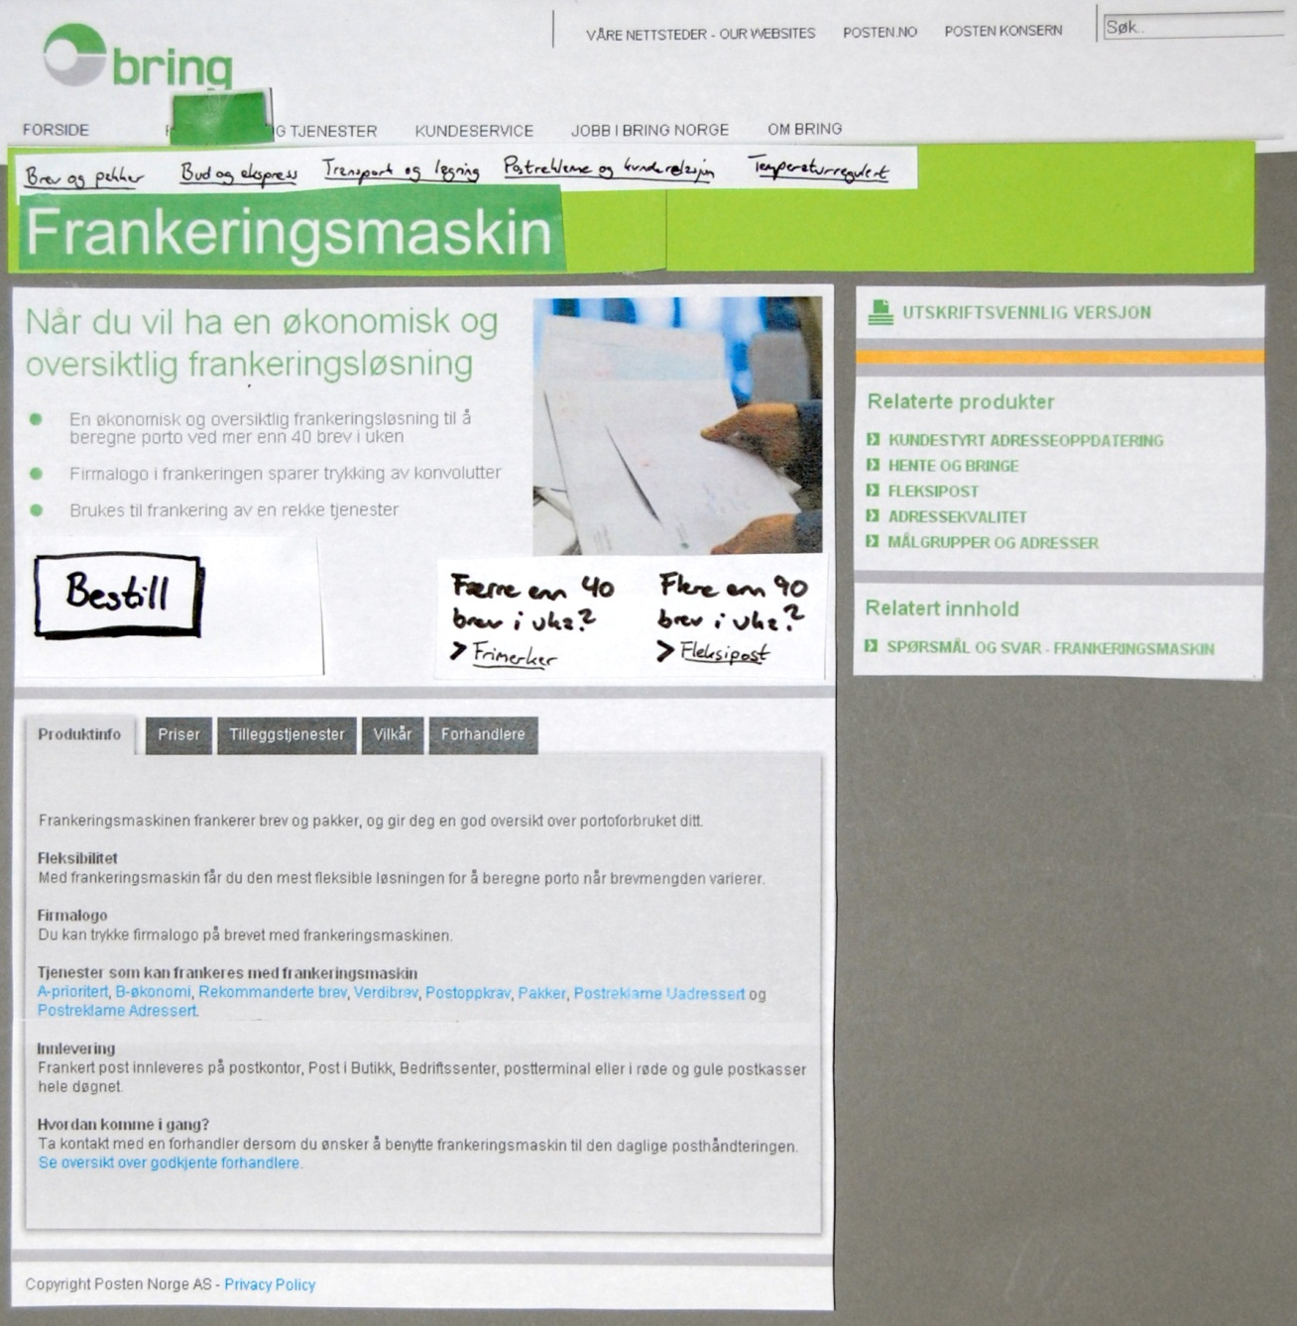

5.
Større kjøpsknapp
Utformes som de andre knappene i designmanualen.
10.
Tilgrensende produkter på produktark.
Tydeligere visning og navigasjon for ”nabo-produkt”
(Estimering tar utgangspunkt i manuell redigering)
Copyright NetLife Research - www.netliferesearch.com - kontakt@netliferesearch.comNetLife Research AS,

Slide 149
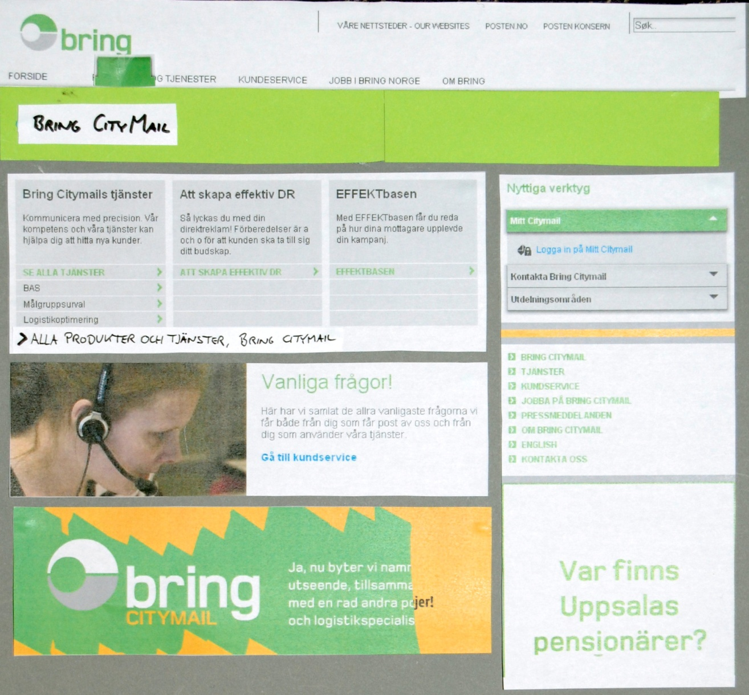

11.
”alle produkter” per spesialist
Ligtbox med alle produkter for den aktuelle spesialisten legges på spesialistforside
Copyright NetLife Research - www.netliferesearch.com - kontakt@netliferesearch.comNetLife Research AS,

Slide 150
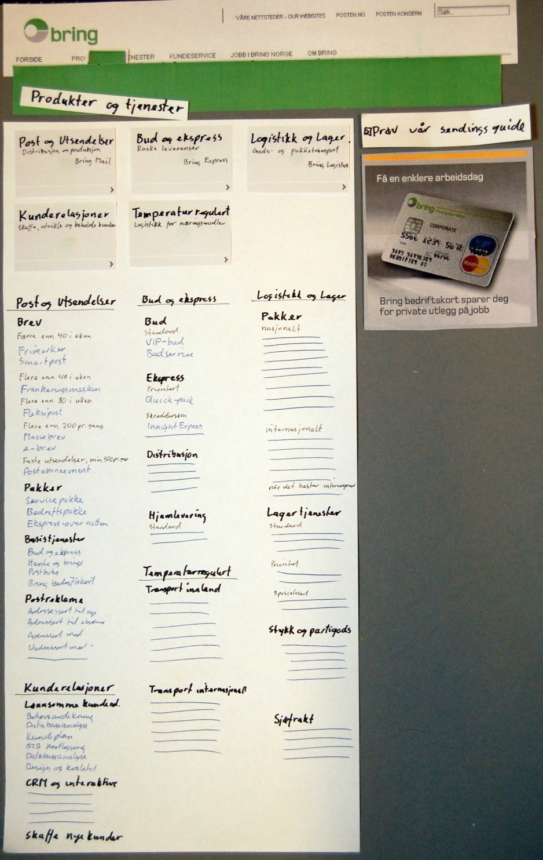

Vise alle produkter og tjenester
8.
Behovsorientert produktinndeling
6.
Vise alle produkter
Alle produkter vises inndelt etter kategorier som hjelper brukerne med å skille produktene fra hverandre.

Slide 151
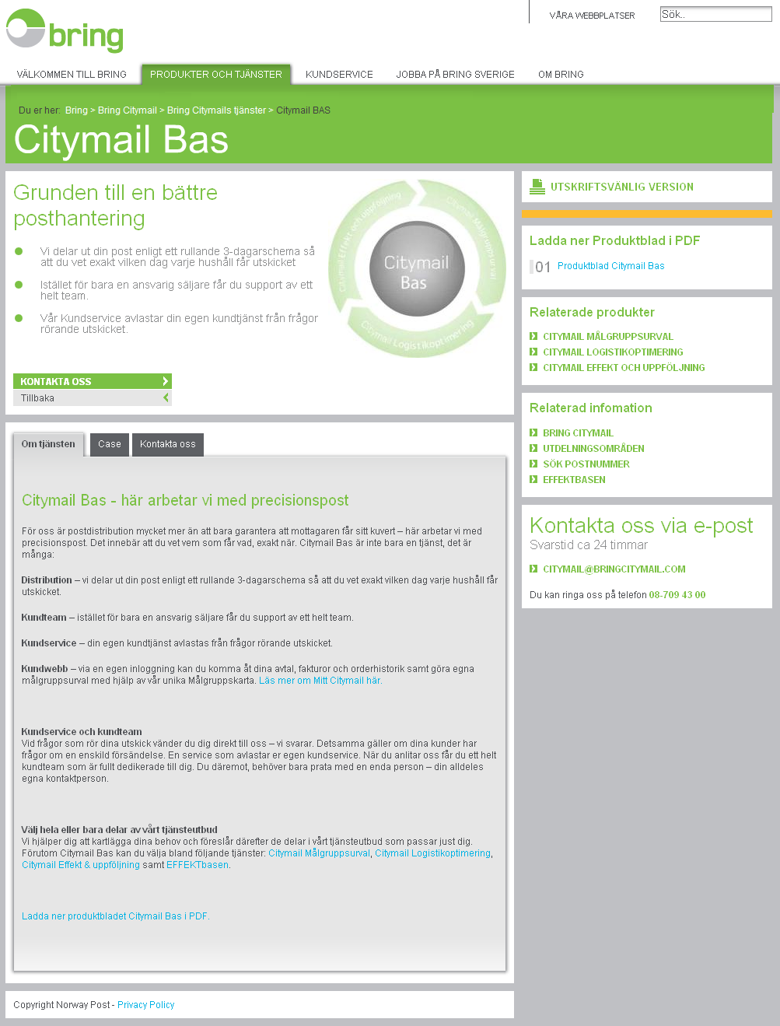

7.
Brødsmulesti
151
Copyright NetLife Research - www.netliferesearch.com - kontakt@netliferesearch.comNetLife Research AS,

Slide 152
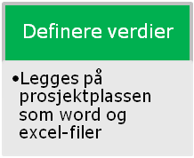
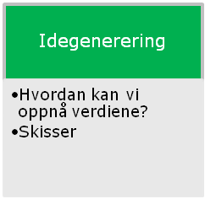
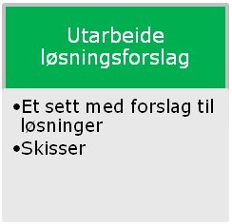
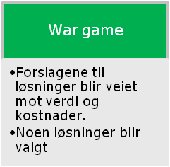
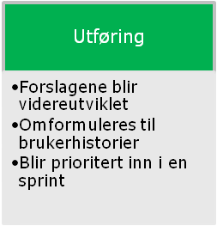


Prosessen
Sprint n
Sprint n + 1
Sprint n + 2

Slide 153

Solution:
Front page sorted by needs
3 sec.
Solution
Find.Fast
Past
[Dec. 2008]
50 sec.
Tolerable
[April 2009]
40 sec.
Goal
[April 2009]
15 sec.
Copyright: Kai@Gilb.com

Slide 154
Solution:
Opportunity to buy from search-results page
2 sec.
Solution
Find.Fast
Past
[Dec. 2008]
50 sec.
Tolerable
[April 2009]
40 sec.
Goal
[April 2009]
15 sec.
Copyright: Kai@Gilb.com

Slide 155
Solution:
Product comparison in search
5 sec.
Solution
Find.Fast
Past
[Dec. 2008]
50 sec.
Tolerable
[April 2009]
40 sec.
Goal
[April 2009]
15 sec.
Copyright: Kai@Gilb.com

Slide 156
Solution:
Service Guide
20 sec.
Solution
Find.Fast
Past
[Dec. 2008]
50 sec.
Tolerable
[April 2009]
40 sec.
Goal
[April 2009]
15 sec.
Copyright: Kai@Gilb.com

Slide 157
Solution:
Training
30 sec.
Solution
Find.Fast
Past
[Dec. 2008]
50 sec.
Tolerable
[April 2009]
40 sec.
Goal
[April 2009]
15 sec.
Copyright: Kai@Gilb.com

Slide 158

Wargame
Value Decision Table
Sorted.Needs
Service Guide
Find.Fast
Resources. External
Resources. Internal
Copyright: Kai@Gilb.com
158

Slide 159
Wargame
Value Decision Table
Copyright: Kai@Gilb.com

Slide 160
”Gode nettsider krever prioriteringer.
Når det er mange hensyn å ta, kan resultatet lett bli en jungel som ingen finner fram i.
Evo hjelper prosjektet med å prioritere hensyn opp mot hverandre og å fokusere på det som vil gi størst verdi. Evo hjelper oss til ikke å miste synet av stjernen vi seiler skuta etter.”
Gjermund Alsos
Senior usability specialist
NetLife Research, Storgata 2, 6.etg., 0155 Oslo
Mobil: (+47) 99 50 40 78 | Kontortelefonen vår: (+47) 22 42 46 42
http://www.netliferesearch.no | http://www.iallenkelhet.no | http://www.badusability.com
Copyright: Kai@Gilb.com

Slide 161
”Good websites require prioritization. When there are many needs to consider the result can quickly become a jungle that no one can navigate through.
Value Management helps the project to prioritize needs up against each other and to focus on that which will give the biggest Value.
Value Management helps us not to loose sight of the star we are sailing the ship towards.
Gjermund Alsos
Senior usability specialist
NetLife Research, Storgata 2, 6.etg., 0155 Oslo
Mobil: (+47) 99 50 40 78 | Kontortelefonen vår: (+47) 22 42 46 42
http://www.netliferesearch.no | http://www.iallenkelhet.no | http://www.badusability.com
Copyright: Kai@Gilb.com
Notes:
”Gode nettsider krever prioriteringer. Når det er mange hensyn å ta, kan resultatet lett bli en jungel som ingen finner fram i.
Evo hjelper prosjektet med å prioritere hensyn opp mot hverandre og å fokusere på det som vil gi størst verdi. Evo hjelper oss til ikke å miste synet av stjernen vi seiler skuta etter.”

Slide 162
Learn
Stakeholders
Measure
Values
Develop
Develop the packages that
deliver the Value.
Deliver
Solutions
Develop
Decompose
Copyright: Kai@Gilb.com
162

Slide 163

163

Slide 164


Slide 165


Slide 166

about
75
services

Slide 167

11
services

Slide 168

7
services

Slide 169

1
service

Slide 170


Slide 171

about
75
services
171

Slide 172

12
services

Slide 173

11
services

Slide 174

2
services

Slide 175
Learn
Stakeholders
Measure
Values
Measure Change
Measure how much the Values changed.
Deliver
Solutions
Develop
Decompose
Copyright: Kai@Gilb.com
175

Slide 176


?
20 sec.
Past
[Dec. 2008]
50 sec.
Tolerable
[April 2009]
40 sec.
Goal
[April 2009]
15 sec.
176

Slide 177
?
Copyright: Kai@Gilb.com
177

Slide 178
“Our challenge is to measure in practice”
Anne Hognestad
Project Owner:
anne.hognestad@posten.no
Copyright: Kai@Gilb.com
Notes:
”Utfordringen vår er å få til måling”

Slide 179
Measurements:
Establishing Past Levels
Past
[March. 2008]
?? sec.
Scale: Average time, in seconds, a User with def. [User-Experience, default=Normal] uses to find what they and we want them to find.
Copyright: Kai@Gilb.com
Notes:
Kvantifiseringsskala: Gjennomsnittlig tid, i sekunder, en Bruker med def. [Bruker-Ekspertise, standardverdi Normal] bruker for å finne det de og vi ønsker at de skal finne.

Slide 180
Use Cases:
1. Send a contract to another company in Oslo. It has to be delivered within two hours
Correct: (Express – Budservice)
2. Send five books to an office in Trondheim. The time it takes is not critical.
  Correct: (Logistics – Bedriftspakke Dør-til-Dør)
3. You are selling sofas. You store them in Kolbotn and ship them to customers accross the country. Find a service to deliver the sofas from your wearhouse to your customers home.
  Correct: (Logistics – Hjemlevering, Nasjonalt gods)
  4. You have a container stocked with bicycles that you are going to ship to South-Africa. Find a product/service that will do this for you.
  Correct: (Logistics – FCL, Full Containerlast)
5. You are expecting a shipment of frozen vegetables. Find a service to store them for 2-3 months.
  Correct: (Frigoscandia – Fryselagring, Lagertjenester)
6. You want to send advertising to children families in Tvedestrand and want to add addresses that you do not have in your customer database.
  Correct: (Dialogue – Målgrupper og adresser)
7. You are tasked by your company to find the most profitable way for them to send mail. Your company normaly sends about 500 to 600 letters a month.
  Correct: (Mail – Fleksipost)
8. You have already sent out an offer to a list of potential customers, and you now want to send to the customers that have not responded, an followup offer. Find the service.Correct: (CityMail – Effekt och oppföljning)
Copyright: Kai@Gilb.com
180
Notes:
Use Cases:
1. Du skal sende en kontrakt til et annet firma i Oslo. Den må være framme innen to timer.
Correct: (Express – Budservice)
2. Du skal sende fem bøker til et kontor i Trondheim. Det er ikke så farlig hvor fort det går.
Correct: (Logistics – Bedriftspakke Dør-til-Dør)
3. Du selger sofaer. Du har et lager på Kolbotn og sender til forskjellige kunder over hele landet. Kan du finne et produktet/tjeneste for å levere sofaer fra lageret og hjem til kunden?
Correct: (Logistics – Hjemlevering, Nasjonalt gods)
4. Du har en container med sykler som skal sendes til Sør-Afrika. Finn et produkt/tjeneste som gjør deg i stand til dette.
Correct: (Logistics – FCL, Full Containerlast)
5. Du venter et parti frosne grønnsaker, som du skal lagre i 2–3 måneder.
Correct: (Frigoscandia – Fryselagring, Lagertjenester)
6. Du skal sende reklame til barnefamilier i Tvedestrand og ønsker adresser du ikke allerede har i kunderegisteret ditt.
Correct: (Dialogue – Målgrupper og adresser)
7. Du skal finne den mest lønnsomme måten å sende post på, for din bedrift. Dere sender vanligvis 500–600 brev i måneden.
Correct: (Mail – Fleksipost)
8. Du har sendt tilbud til en rekke potensielle kunder, og ønsker nå å sende ut en oppfølging til de som ikke har svart.
Correct: (CityMail – Effekt och oppföljning)

Slide 181
Penalty Time:
Wrong Service: The service the user chose would NOT do the task.
+300 seconds.
Suboptimal Service: The service the user chose could do the task, but it is not the optimal service.
+30-120 seconds
Copyright: Kai@Gilb.com
181

Slide 182

Result data from testing 5 users on Find.Fast
197 seconds
Copyright: Kai@Gilb.com
182

Slide 183
Measurements:
Establishing Past Levels
Past
[March 2008]
197 seconds
Scale: Average time, in seconds, a User with def. [User-Experience, default=Normal] uses to find what they and we want them to find.
Copyright: Kai@Gilb.com
Notes:
Skala: Gjennomsnittlig tid, i sekunder, en Bruker med def. [Bruker-Ekspertise, standardverdi Normal] bruker for å finne det de og vi ønsker at de skal finne.

Slide 184
Measurements:
Establishing Status Levels
-?? sec.
Past
[March 2008]
Status
[May. 2009]
??? sec.
197 seconds
Scale: Average time, in seconds, a User with def. [User-Experience, default=Normal] uses to find what they and we want them to find.
Copyright: Kai@Gilb.com
Notes:
Skala: Gjennomsnittlig tid, i sekunder, en Bruker med def. [Bruker-Ekspertise, standardverdi Normal] bruker for å finne det de og vi ønsker at de skal finne.

Slide 185
Measurements:
Establishing Status Levels
-49 sec.
Past
[March 2008]
Status
[May. 2009]
148 sec.
197 seconds
Scale: Average time, in seconds, a User with def. [User-Experience, default=Normal] uses to find what they and we want them to find.
Copyright: Kai@Gilb.com
Notes:
Skala: Gjennomsnittlig tid, i sekunder, en Bruker med def. [Bruker-Ekspertise, standardverdi Normal] bruker for å finne det de og vi ønsker at de skal finne.

Slide 186
Learn
Stakeholders
Measure
Values
Learn & Change
Learning is defined as a change in behavior.
Deliver
Solutions
Develop
Decompose
Copyright: Kai@Gilb.com
186

Slide 187


?

Slide 188
Noen interessante observasjoner:
• Det tar ca 54 sekunder å finne fram til en budtjeneste. Spennet ligger fra 9 til 111 sekunder.
• Siden med "Standard, prioritert, skreddersøm" osv. gjorde at flere brukere stoppet opp, måtte prøve seg fram og starte på nytt. Dette mister vi mye tid på.
• De brukerne som innledningsvis valgte feil spesialist, brukte lang tid før de fant fram.
• Som ventet ble mestparten av tiden brukt på navigasjonssider, men i noen tilfeller brukte testpersonene mer tid på å lese produktarkene for å forstå dem, enn å finne produktarkene.
• Det tok generelt lengre tid å finne produkter under logistikk.
• Under halvparten fant det produktet vi hadde definert som Correct, men ved nærmere ettersyn ville opp mot 90% av produktene brukerne fant helt eller delvis kunnet oppfylle brukerens behov.
Copyright: Kai@Gilb.com
188

Slide 189
Copyright: Kai@Gilb.com
189

Slide 190
Value Decision Tables
Business Goals | Training Costs | User Productivity
Profit | -10% | 40%
Market Share | 50% | 10%
Resources | 20% | 10%
Stakeholder Val. | Intuitiveness | Find.Fast
Training Costs | -10% | 50 %
User Productivity | 10 % | 10%
Resources | 2 % | 5 %
Product Values | GUI Style Rex | Service Guide
Find.Fast | -10% | 40%
Performance | 50% | 80 %
Resources | 1 % | 2 %
Prioritized List
1. Service Guide
2. Solution 9
3. Solution 7
Scrum Develop
We measure improvements
Learn and Repeat
Copyright: Kai@Gilb.com
190

Slide 191
Value Decision Table
Solutions
Product
Values
Sorted.Needs
Service Guide
Find.Fast
Resources. External
Resources. Internal
Copyright: Kai@Gilb.com

Slide 192

Value Decision Tables
Business Goals | Training Costs | User Productivity
Profit | -10% | 40%
Market Share | 50% | 10%
Resources | 20% | 10%
Stakeholder Val. | Intuitiveness | Find.Fast
Training Costs | -10% | 50 %
User Productivity | 10 % | 10%
Resources | 2 % | 5 %
Product Values | GUI Style Rex | Service Guide
Find.Fast | -10% | 35 %
Performance | 50% | 80 %
Resources | 1 % | 2 %
Prioritized List
1. Service Guide
2. Solution 9
3. Solution 7
Scrum Develop
We measure improvements
Learn and Repeat
Copyright: Kai@Gilb.com
192

Slide 193
Product
Values
Find.Fast
Stakeholder
Values
Copyright: Kai@Gilb.com
193

Slide 194
Stakeholder
Values

Slide 195

Stakeholder Value Examples
KFS.Charging Scale: number of customers per month that charge their postage meter “frankeringsmaskin” on www.Bring.no/MailCustomerservice.Contact Scale: % of customers that get the correct answer on their question, the first time they contact Customerservice.
Stakeholder
Values
Copyright: Kai@Gilb.com
195

Slide 196
Stakeholder Value Examples
Sales:Order.Number Scale: number of completed sales per month, from Self.Help.Solutions.
Sales.Leadsgeneration Scale: number of Electronic-Leads per month generated on bring.xx to the Specialists.
SMB.Selfservice Scale: % SMB customers tht use self service solutions rather than other channels.
Stakeholder
Values
Copyright: Kai@Gilb.com
196
Notes:
Salg.bestilling.Antall Skala: Antall gjennomførte salg, pr. mnd., som gir omsetning fra <Selvbetjeningsløsninger.>
Salg.Leadsgenerering Skala: Antall Elektroniske-Leads pr. mnd generert på konsernportalen til spesialistene.
SMB.Selvbetjening Skala: % SMB kunder som bruker selvbetjeningsløsninger fremfor andre kanaler.

Slide 197
Stakeholder
Values
Copyright: Kai@Gilb.com
197

Slide 198

Value Decision Tables
Business Goals | Training Costs | User Productivity
Profit | -10% | 40%
Market Share | 50% | 10%
Resources | 20% | 10%
Stakeholder Val. | Intuitiveness | Find.Fast
Training Costs | -10% | 50 %
User Productivity | 10 % | 10%
Resources | 2 % | 5 %
Product Values | GUI Style Rex | Service Guide
Find.Fast | -10% | 35 %
Performance | 50% | 80 %
Resources | 1 % | 2 %
Prioritized List
1. Service Guide
2. Solution 9
3. Solution 7
Scrum Develop
We measure improvements
Learn and Repeat
Copyright: Kai@Gilb.com
198

Slide 199
Value Decision Table
Stakeholder
Values
Business
Values
Copyright: Kai@Gilb.com

Slide 200
Value Decision Tables
Business Goals | Training Costs | User Productivity
Profit | -10% | 40%
Market Share | 50% | 10%
Resources | 20% | 10%
Stakeholder Val. | Intuitiveness | Find.Fast
Training Costs | -10% | 50 %
User Productivity | 10 % | 10%
Resources | 2 % | 5 %
Product Values | GUI Style Rex | Service Guide
Find.Fast | -10% | 35 %
Performance | 50% | 80 %
Resources | 1 % | 2 %
Prioritized List
1. Service Guide
2. Solution 9
3. Solution 7
Scrum Develop
We measure improvements
Learn and Repeat
Copyright: Kai@Gilb.com
200

Slide 201
Rammeplan - Policy
Nordic: alle løsninger skal være tilrettelagt for å lett kunne brukes i hele Norden. Språk, lov og administrasjon skal vurderes.
Quantified: alle kritiske Business-, Interessent- og Produkt- Verdi Krav skal spesifiseres kvantitativt; inkludert Før, Tolererbart og Mål nivåer med dato.
Value-Priority: løsninger har sin livs rett bare til den grad de tilfredsstiller Verdi Krav for minst mulig ressursbruk. All utvikling skal målrettet tilfredsstille avtalt Verdi Krav.
Early: all utvikling skal demonstrere tilfredsstillelse av Verdi Krav annen hver uke eller hyppigere. Verdi forbedringer skal leveres ”live” eller så nære Interessentene og ”live” som mulig er. Dette gjelder også for helt nye produkter.
Measurment: Alle nye tjenester skal klargjøres for måling med Astrups Insite
Re-Use: det skal tilstrebes at tjenester som utvikles i størst mulig grad skal kunne gjenbrukes
Status: Status nivå på kritiske Verdi Krav skal måles/guestimeres hyppig.

Slide 202



Business Owners
Steering Committee
Push Technical Solutions
Wants to make decisions about Technical Solutions
Project Management
Thinks and understands Technical Solutions
Developers
202

Slide 203



Business Owners
Steering Committee
What are your real needs?
Sign off on Value Improvements
Project Management
What technical solution will give maximum
Product Value improvements?
Developers
203

Slide 204
reflections
av Terje Berget
Produkt Eier
Copyright: Kai@Gilb.com
204

Slide 205
Value Management (EVO)
Fokus på utfordringer som ønskes løst.
Krav som formes med interessenter, som beskriver hva man ønsker forbedret, og en skala for å kunne måle forbedring fra dagens situasjon.
Kravet kvantifiserer ønsket og ”akseptabel” forbedring.
Matrise som viser hvordan krav og løsninger som påvirker hverandre.
Testing av funksjon/oppgaver både før og etter utvikling.
Et videre og mer omfattende fokus enn SCRUM
Scrum
Smidig utvikling, med korte iterasjoner
Sprint – utviklingsperioden, gjerne 2 uker
Product backlog – Hva som ønskes utviklet over tid fra kundens ståsted
Sprint backlog – hva som er avtalt av utvikles i en sprint mellom kunde og leverandør
Scrum Master – leverandørens Prosjektleder
Produkteier – Kundens deltager
Daglige Standup møter

Slide 206
Erfaringer med Evo/Scrum i prosjektet
Terje Berget
Product Owner
Negative
  Utfordrende å ”selge inn” til linjen
  Utfordrende å lage kontrakt mellom kunde og leverandør basert på EVO
  Krever mye forberedelse fra kunden
Copyright: Kai@Gilb.com
206

Slide 207
Erfaringer med Evo/Scrum i prosjektet
  Positive
    Gir stor grad av kostnadskontroll
    Gir godt overblikk over avhengigheter og konsekvenser fra kundens side
    Danner et godt beslutningsgrunnlag for prioriteringer av oppgaver til utvikling
    De med best forutsetninger foreslår løsninger
    Gir engasjement og inspirasjon til leverandøren ift å levere gode løsninger
    Leverer løsninger som ”løser oppgaven”
Terje Berget
Product Owner
Copyright: Kai@Gilb.com
207

Slide 208
Erfaringer med Evo/Scrum i prosjektet
  Positive
    Men: Krever mer forarbeid før utviklingsprosesser fra kunden for å ha kontroll
    Men: Prosessen krever et tillitsforhold mellom kunde og leverandør
Terje Berget
Product Owner
Copyright: Kai@Gilb.com
208

Slide 209

“Our challenge is to, in practice, make payments based on value delivery.”
the road ahead ...
Anne Hognestad
Project Owner:
anne.hognestad@posten.no
Copyright: Kai@Gilb.com
209
Notes:
“Utfordringen vår er å få til målemetode opp mot betaling.”

Slide 210
The Team
Posten
  Webteam - Value Management Certified
    Project Owner: Anne Hognestad anne.hognestad@posten.no
    Product Owner: Terje Berget terje.berget@posten.no
    Lin Smitt-Amundsen & Kristin Nygård
  Many Business Groups and internal stakeholders.
  Kjetil Halvorsen kjetil.halvorsen@posten.no
Bekk & Ergo Group
  Scrum Master: Fredrik Bach fredrik.bach@bekk.no
  Technical Architect: Stefan M. Landrø: stefan.landro@bekk.no
  Graphics: Espen Satver
  Morten Wille Johannessen, Markus Krüger, Dag Stepanenko
NetLife Research
  User Experience: Gjermund Also gjermund@netliferesearch.com Kjell-Morten Bratsberg Thorsen
Kai Gilb: Management Coach: Kai
To download this presentation
You will find it here: http://www.gilb.com/FileGalleries
Direct link: http://bit.ly/BringCase
Copyright: Kai@Gilb.com @kaigilb
210

Slide 211
Notes:
Jens Case or Summary?

Slide 212

And now,
we present to you the Case study of:
this peep project done by peep peep peep
212

Slide 213

total hours to complete job
4 hours faster before first meeting with the steering committee.
Decided not to plan, but to do immediately
213

Slide 214


?
!
Job Description:
Implement a specific CRM system in a big telecom organization.
Jens Evensen - Avenir
Notes:
Mr Jens Evensen
What would / should you do?
Let me tell you what he did!

Slide 215


Learn
Stakeholders
Measure
Values
Deliver
Solutions
Develop
Decompose

Slide 216



Forget CRM, what do you want to achieve?
Learn
Stakeholders
?
Measure
Values
Deliver
Solutions
Develop
Decompose
Notes:
What is the magic word
75 million kr case
One of my earlier students, told me how he had gotten an assignment as a project manager to install a
One of my students, <<Jack>> told me with enthusiasm how he was assigned the job of implementing a <<PRA>> system in an organization. His company was given the job from Microsoft, with instructions on a specific MS <<PRA>> system, and what functionality it had to have. At this point, he could have gone ahead and used 6 months to integrate the system into the organization. The organization would have ended up with a technical <<PRA>> system that might have been useful/integrated/valuable or not to the organization. But being a practitioner of Evo, he started with identifying the Stakeholders. It turned out that the main Stakeholder was the CEO of the company. To understand the Stakeholder Values he arranged a meeting with the CEO and asked him why he had initiated the purchase of the <<PRA>> system. He learned that the CEO had identified that they lost $12M in each year, caused by deadline of contracts not being respected and that no one knew about it before they got the bills. The CEO hoped that a <<PRA>> system could help them get control over the yearly $12M in lost contracts. But in the original instructions given to <<Jack>> from Microsoft , there was no mention of lost contracts. He told me that had he not taken the trouble to identify the Stakeholders (CEO) and their critical values (save yearly $12M per year in lost contracts) his team would not have done anything with the lost contracts, ever.
The in true Evo spirit, <<Jack>> looked for how he could deliver value to the organization early, and found that he could, within one week, install a version of the <<PRA>> system that fed live contract information into the system, identify the contracts that was going out on date, and flag them in time for for the CEO and his team to act on them. This lead to that the immediate yearly savings of $12M. The CEO was as estatic as he was amazed about the early results.The <<PRA>> system was far from fully integrated into all the different data bases the organization had, nor was it in use by anyone else than the CEO.
It gave <<Jack>> instant credibility, and full support from the CEO. <<Jack>> was smiling from ear to ear when telling me all this. He could now focus on identifying the other Stakeholders, their Stakeholder Values, and integrating the <<PRA>> system in such a way as to deliver the thought after values.

Slide 217
Not losing
€ 9.300.000,-
per Year
Learn
Stakeholders
Measure
Values
Deliver
Solutions
Develop
Decompose
Notes:
75 million kr case
One of my earlier students, told me how he had gotten an assignment as a project manager to install a
One of my students, <<Jack>> told me with enthusiasm how he was assigned the job of implementing a <<PRA>> system in an organization. His company was given the job from Microsoft, with instructions on a specific MS <<PRA>> system, and what functionality it had to have. At this point, he could have gone ahead and used 6 months to integrate the system into the organization. The organization would have ended up with a technical <<PRA>> system that might have been useful/integrated/valuable or not to the organization. But being a practitioner of Evo, he started with identifying the Stakeholders. It turned out that the main Stakeholder was the CEO of the company. To understand the Stakeholder Values he arranged a meeting with the CEO and asked him why he had initiated the purchase of the <<PRA>> system. He learned that the CEO had identified that they lost $12M in each year, caused by deadline of contracts not being respected and that no one knew about it before they got the bills. The CEO hoped that a <<PRA>> system could help them get control over the yearly $12M in lost contracts. But in the original instructions given to <<Jack>> from Microsoft , there was no mention of lost contracts. He told me that had he not taken the trouble to identify the Stakeholders (CEO) and their critical values (save yearly $12M per year in lost contracts) his team would not have done anything with the lost contracts, ever.
The in true Evo spirit, <<Jack>> looked for how he could deliver value to the organization early, and found that he could, within one week, install a version of the <<PRA>> system that fed live contract information into the system, identify the contracts that was going out on date, and flag them in time for for the CEO and his team to act on them. This lead to that the immediate yearly savings of $12M. The CEO was as estatic as he was amazed about the early results.The <<PRA>> system was far from fully integrated into all the different data bases the organization had, nor was it in use by anyone else than the CEO.
It gave <<Jack>> instant credibility, and full support from the CEO. <<Jack>> was smiling from ear to ear when telling me all this. He could now focus on identifying the other Stakeholders, their Stakeholder Values, and integrating the <<PRA>> system in such a way as to deliver the thought after values.

Slide 218
I can fix that in 2 weeks!
Learn
Stakeholders
Measure
Values
Deliver
Solutions
Develop
Decompose
Notes:
75 million kr case
One of my earlier students, told me how he had gotten an assignment as a project manager to install a
One of my students, <<Jack>> told me with enthusiasm how he was assigned the job of implementing a <<PRA>> system in an organization. His company was given the job from Microsoft, with instructions on a specific MS <<PRA>> system, and what functionality it had to have. At this point, he could have gone ahead and used 6 months to integrate the system into the organization. The organization would have ended up with a technical <<PRA>> system that might have been useful/integrated/valuable or not to the organization. But being a practitioner of Evo, he started with identifying the Stakeholders. It turned out that the main Stakeholder was the CEO of the company. To understand the Stakeholder Values he arranged a meeting with the CEO and asked him why he had initiated the purchase of the <<PRA>> system. He learned that the CEO had identified that they lost $12M in each year, caused by deadline of contracts not being respected and that no one knew about it before they got the bills. The CEO hoped that a <<PRA>> system could help them get control over the yearly $12M in lost contracts. But in the original instructions given to <<Jack>> from Microsoft , there was no mention of lost contracts. He told me that had he not taken the trouble to identify the Stakeholders (CEO) and their critical values (save yearly $12M per year in lost contracts) his team would not have done anything with the lost contracts, ever.
The in true Evo spirit, <<Jack>> looked for how he could deliver value to the organization early, and found that he could, within one week, install a version of the <<PRA>> system that fed live contract information into the system, identify the contracts that was going out on date, and flag them in time for for the CEO and his team to act on them. This lead to that the immediate yearly savings of $12M. The CEO was as estatic as he was amazed about the early results.The <<PRA>> system was far from fully integrated into all the different data bases the organization had, nor was it in use by anyone else than the CEO.
It gave <<Jack>> instant credibility, and full support from the CEO. <<Jack>> was smiling from ear to ear when telling me all this. He could now focus on identifying the other Stakeholders, their Stakeholder Values, and integrating the <<PRA>> system in such a way as to deliver the thought after values.

Slide 219

“and so he did !”
Saving his client about
€ 9.300.000,- per Year
Learn
Stakeholders
Measure
LosingContracts
Scale: € lost per year, in expiring contracts.
Past [at meeting] €9.300.000.-
Goal [2 weeks later] €0.-
Values
Deliver
Solutions
Develop
Decompose
Jens Evensen - Avenir
Notes:
Jens (picture) given job to implement a CRM system, went to Stakeholder, and gave him what he really wanted first week. what risk was left?

Slide 220







Paradigm Shift
With EVO, our requirements process changed.
Previously we focused mostly on function requirements.
We realized that it’s the product quality (value) requirements that really separate us from our competitors.
Notes:
Confirmit decided to focus 100% attention on the value requirements.

Slide 221



Slide 222
take home points
Copyright: Kai@Gilb.com
222

Slide 223
Notes:
take home points

Slide 224
Clear Quantified
Stakeholder Values
Product Values
Find.Fast
Past
[Dec. 2008]
50 sec.
Tolerable
[April 2009]
40 sec.
Goal
[April 2009]
15 sec.
Copyright: Kai@Gilb.com

Slide 225
Value Decision Tables
 | Training Costs | User Productivity
Profit | -10% | 40%
Market Share | 50% | 10%
Resources | 20% | 10%
Connect all levels
 | Intuitiveness | Find.Fast
Training Costs | -10% | 50 %
User Productivity | 10 % | 10%
Resources | 2 % | 5 %
 | GUI Style Rex | Service Guide
Find.Fast | -10% | 35 %
Performance | 50% | 80 %
Resources | 1 % | 2 %
Prioritized List
1. Service Guide
2. Solution 9
3. Solution 7
Scrum Develop
We measure improvements
Learn and Repeat
Copyright: Kai@Gilb.com
225

Slide 226
Value Decision Tables
 | Training Costs | User Productivity
Profit | -10% | 40%
Market Share | 50% | 10%
Resources | 20% | 10%
The secret
of a powerful
product backlog
is...
 | Intuitiveness | Find.Fast
Training Costs | -10% | 50 %
User Productivity | 10 % | 10%
Resources | 2 % | 5 %
 | GUI Style Rex | Service Guide
Find.Fast | -10% | 35 %
Performance | 50% | 80 %
Resources | 1 % | 2 %
Prioritized List
1. Service Guide
2. Solution 9
3. Solution 7
Scrum Develop
We measure improvements
Learn and Repeat
Copyright: Kai@Gilb.com
226
Notes:
A powerfull
Product Backlog
requires Continious Prioritization
from top to toe

Slide 227
Value Decision Tables
 | Training Costs | User Productivity
Profit | -10% | 40%
Market Share | 50% | 10%
Resources | 20% | 10%
continuous prioritization
based on
Value Delivered
over costs
 | Intuitiveness | Find.Fast
Training Costs | -10% | 50 %
User Productivity | 10 % | 10%
Resources | 2 % | 5 %
 | GUI Style Rex | Service Guide
Find.Fast | -10% | 35 %
Performance | 50% | 80 %
Resources | 1 % | 2 %
Prioritized List
1. Service Guide
2. Solution 9
3. Solution 7
Scrum Develop
We measure improvements
Learn and Repeat
Copyright: Kai@Gilb.com
227
Notes:
A powerfull
Product Backlog
requires Continious Prioritization
from top to toe

Slide 228
deliver value to stakeholders, within agreeable resources.
Notes:
We can deliver value to stakeholders,
we should deliver value to stakeholders
and we must deliver value to stakeholder.
Vi kan levere verdi til intresentene, vi burde levere verdi til intresentene, vi må levere verdi til intresentene.
‘We can do this thing, we should do this thing and we must do this thing.’

Slide 229
What you can do immediately!
List your Stakeholders
Quantify their critical Values
For every Solution/Strategy, check that it impacts the critical Values.

Slide 230
We have a challenge ...
Notes:
We can make Management embrace Agile, we should make Management Agile, we must direct Agile towards satisfaction of stakeholder values.
Vi kan få ledere til å omfavne Smidig, vi burde endre
‘We can do this thing, we should do this thing and we must do this thing.’

Slide 231
?

Slide 232

End of Slides
www.Gilb.com

